Slide 1
Label Writing

Slide 2
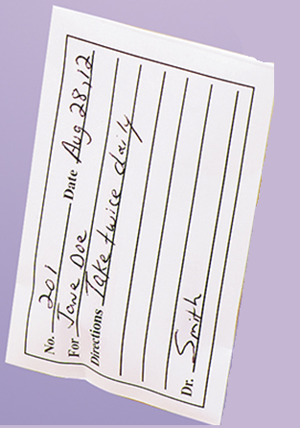
No. =Total number of pills
Date= Date filled (contest date)
For= “Patient” and client name
**note must put both**
Directions= Write out directions so that the owner can read.
Make sure to include
Medication (concentration)- take ## of pills ## of times a day.
Dr. You may put your name

