Slide 1
Plant Names

Slide 2
Achillea millefolium

Slide 3
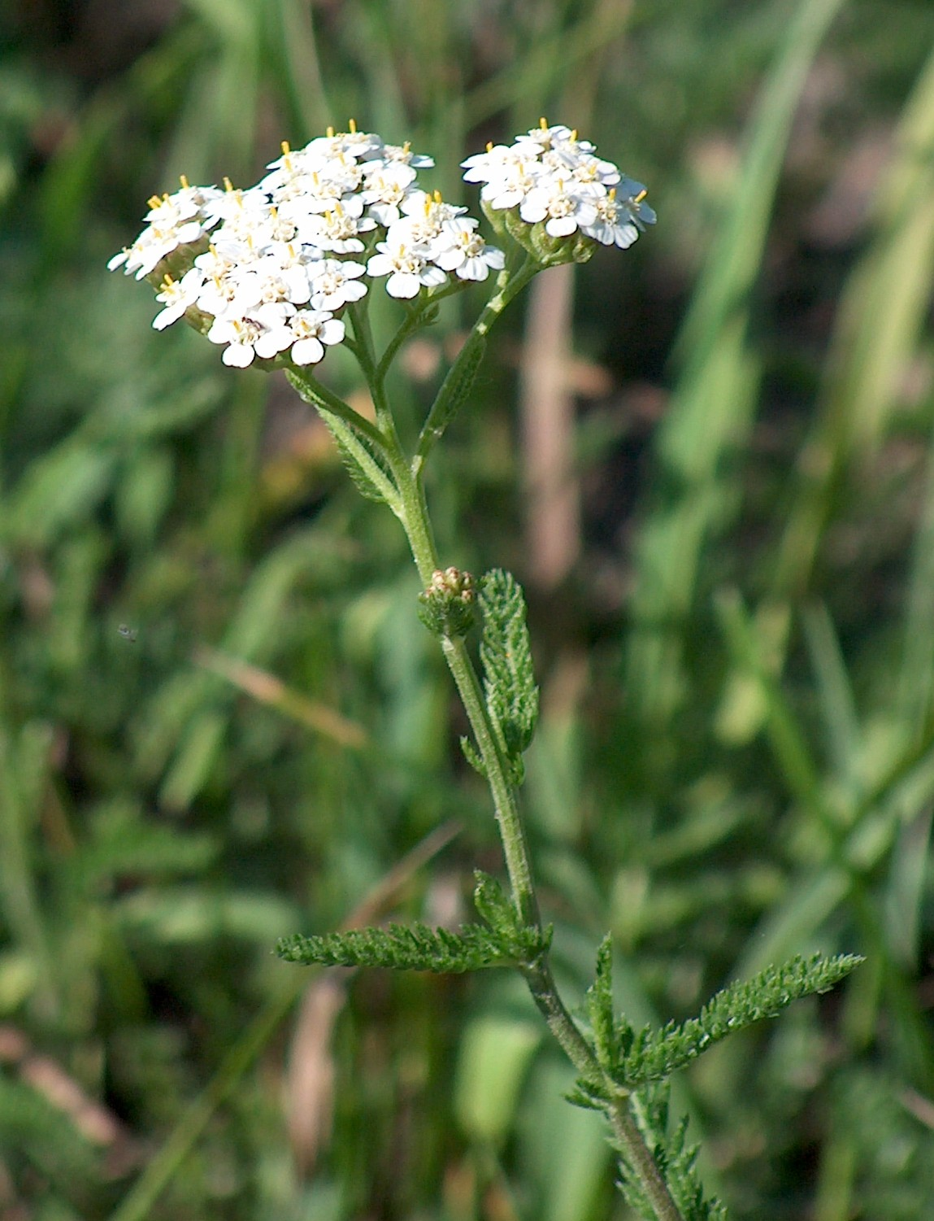
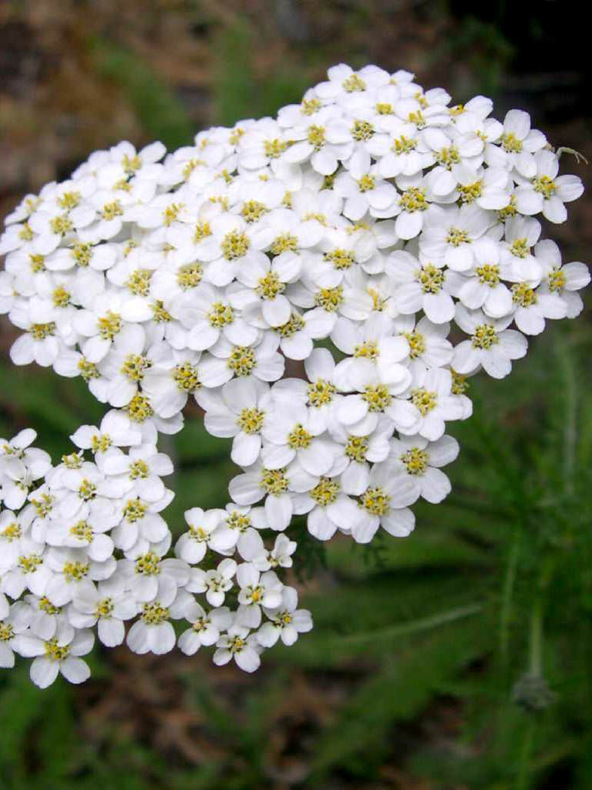

Slide 4
Ageratum houstonianum

Slide 5
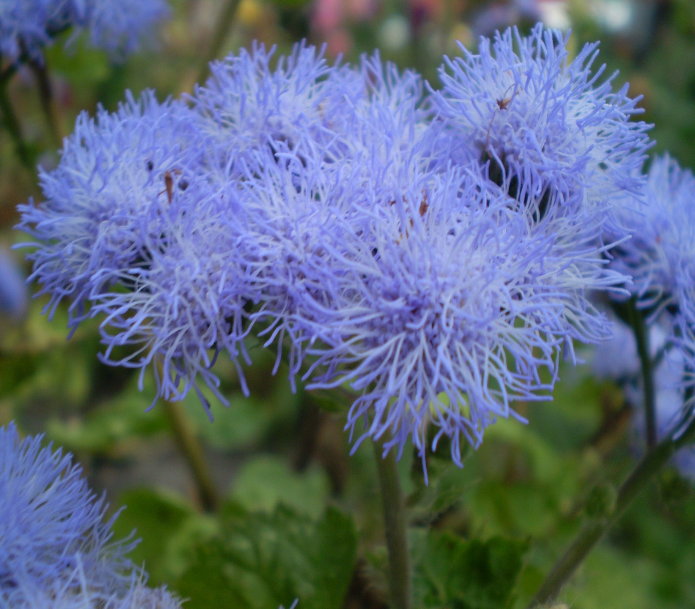
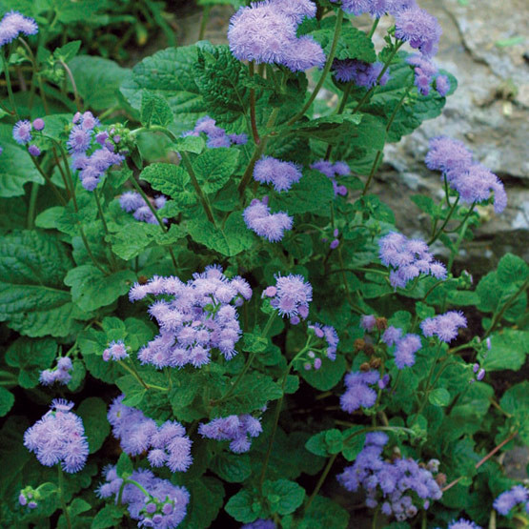

Slide 6
Aglaonema nitidum ‘Silver Queen’

Slide 7
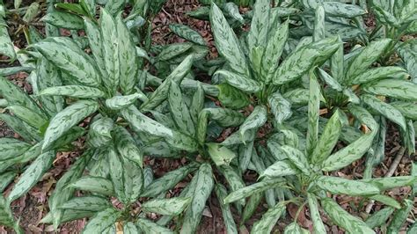
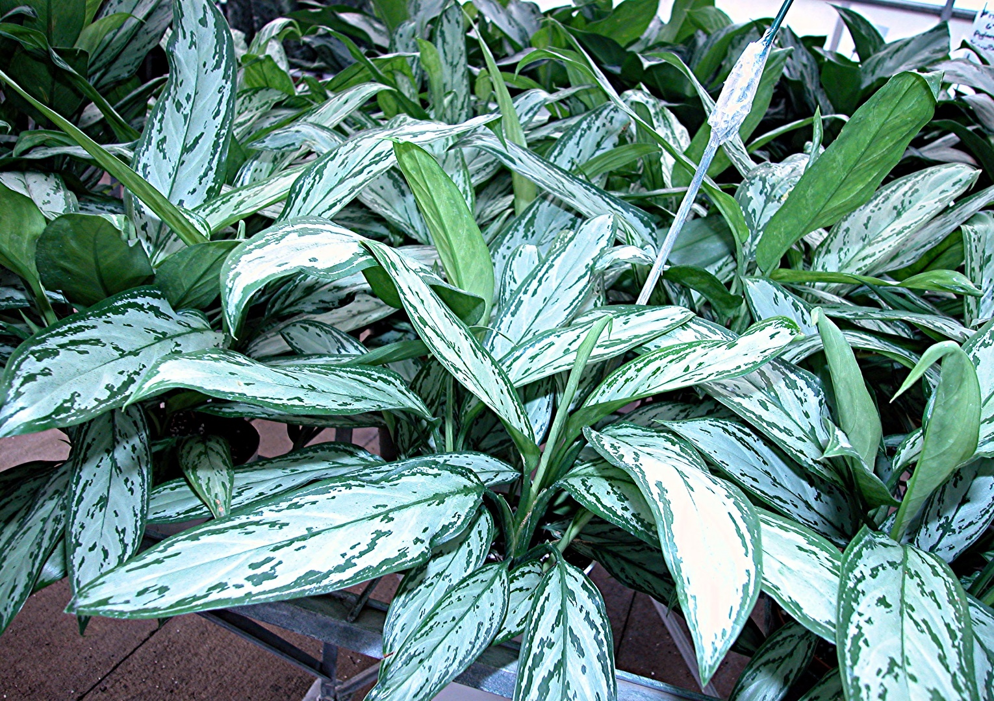
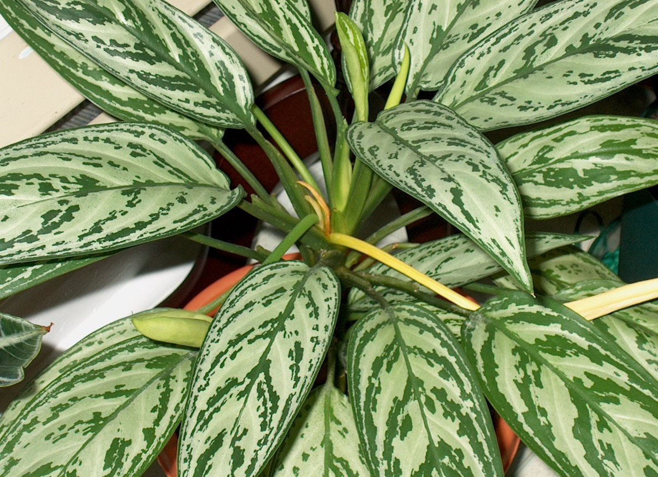

Slide 8
Allium schoenoprasum

Slide 9
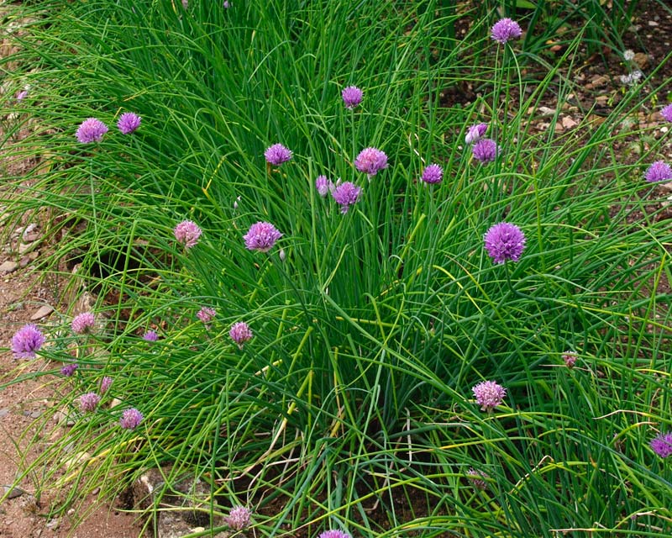
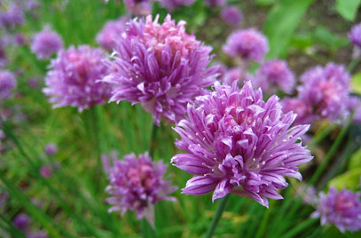

Slide 10
Antirrhinum majus

Slide 11
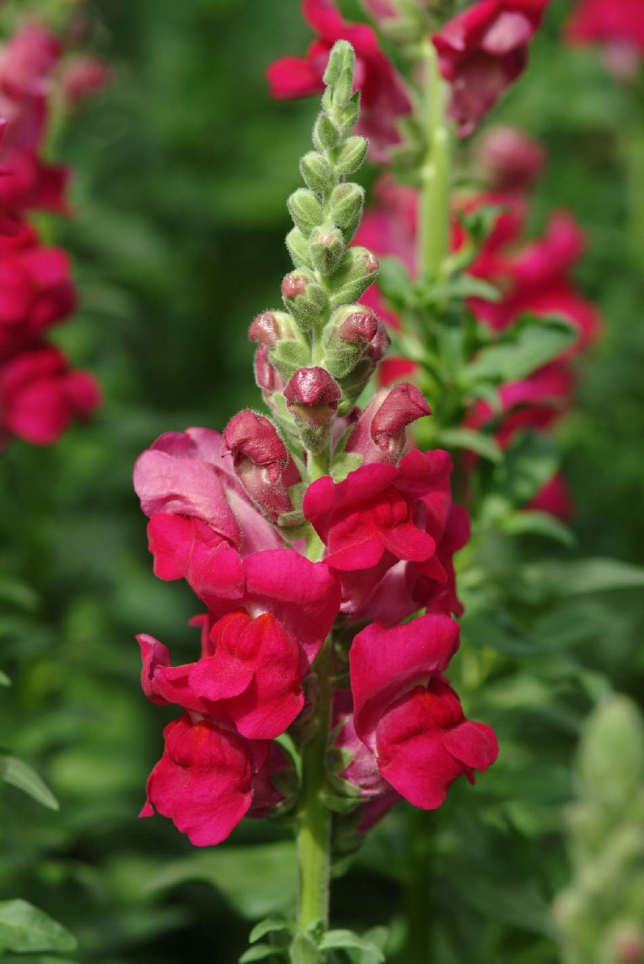
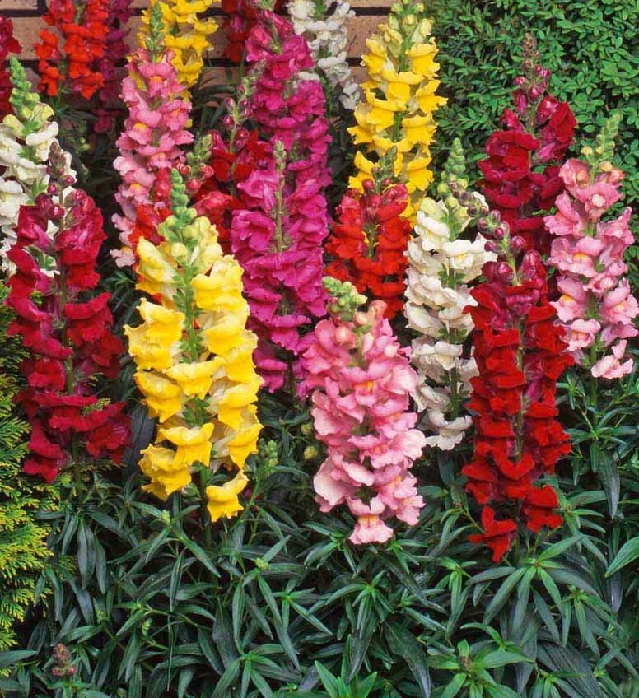
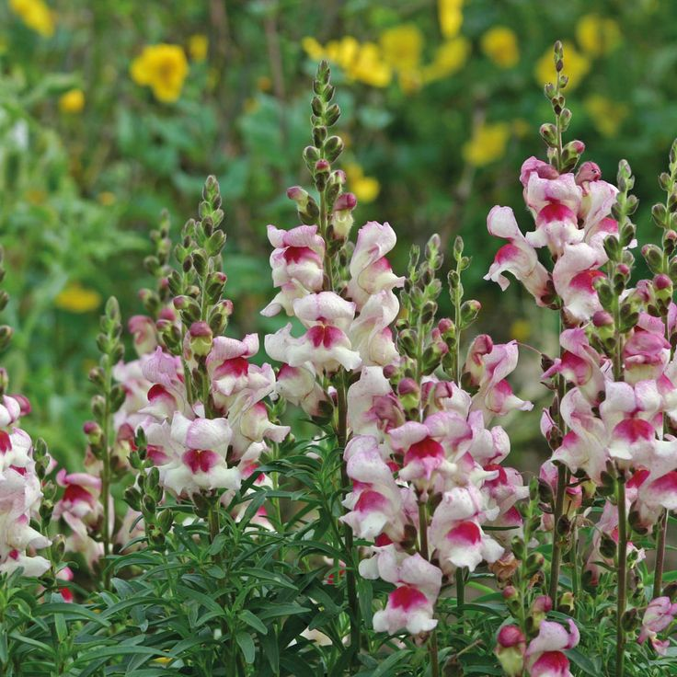

Slide 12
Aquilegia x hybrida

Slide 13
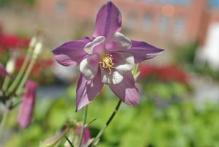
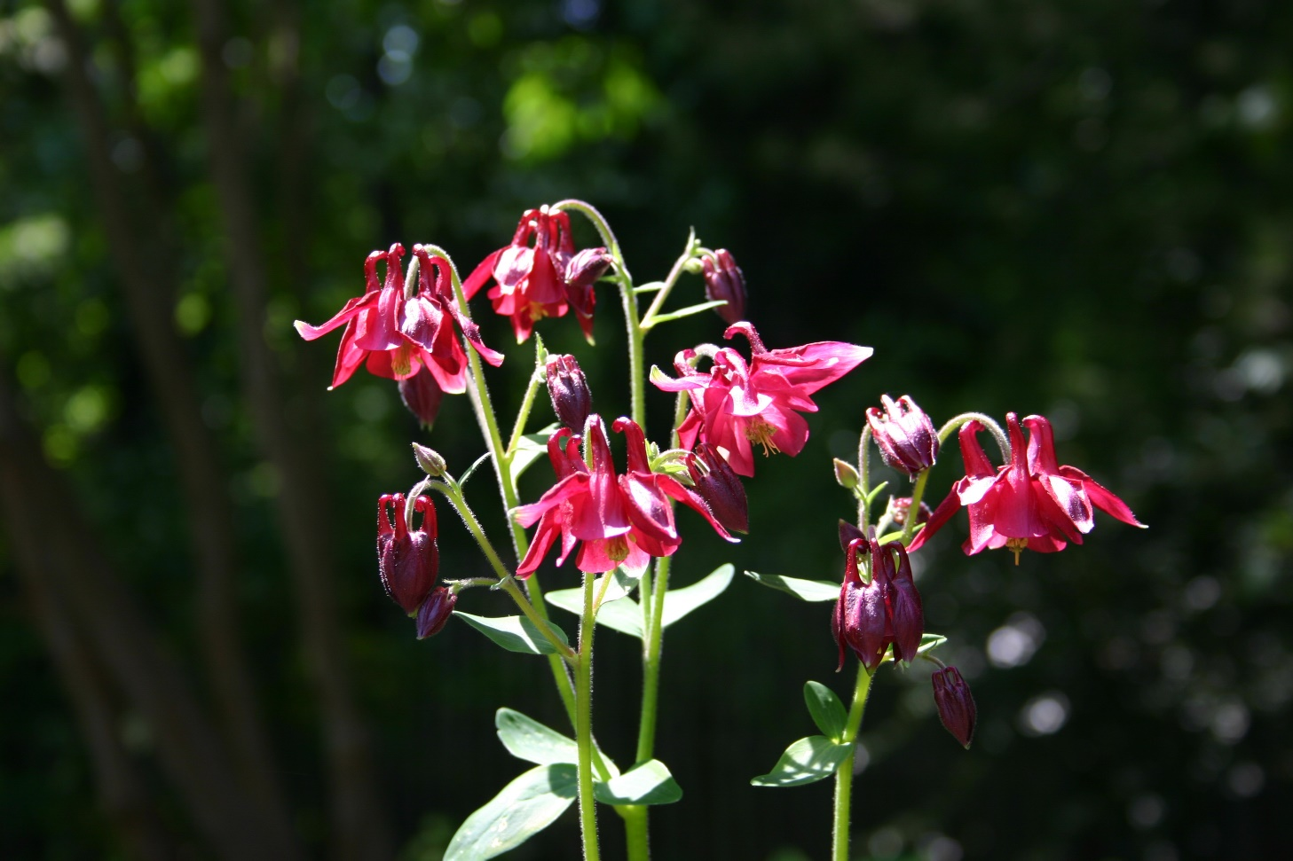
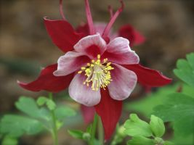

Slide 14
Araucaria heterophylla

Slide 15
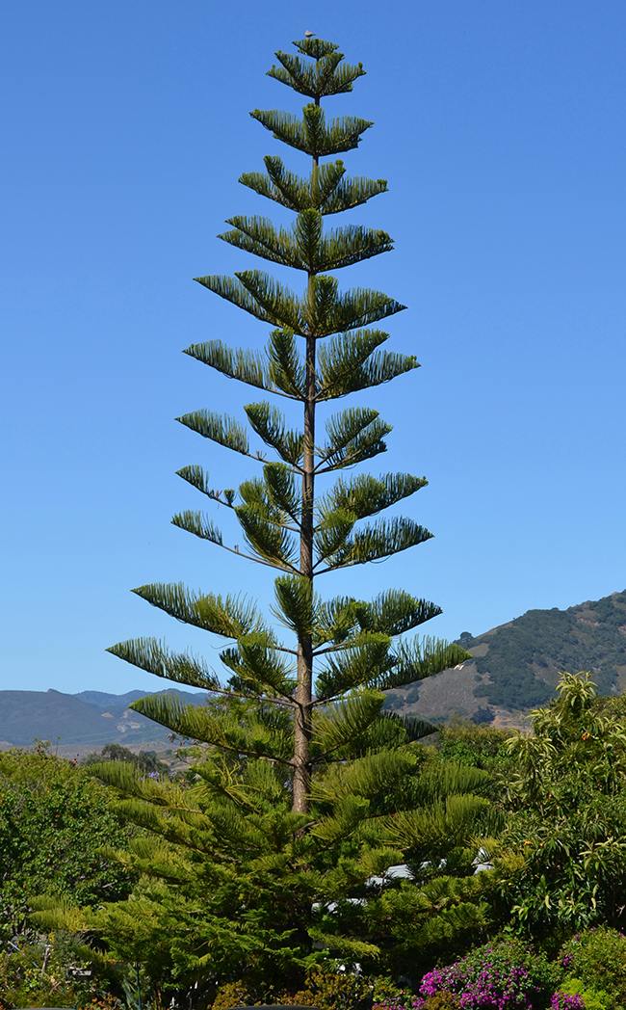
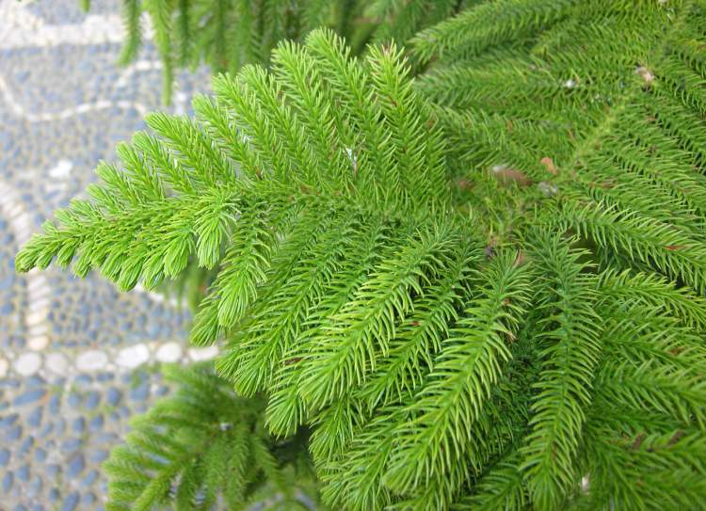

Slide 16
Artemisia schmidtiana

Slide 17
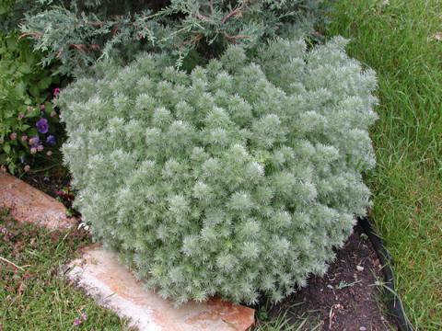
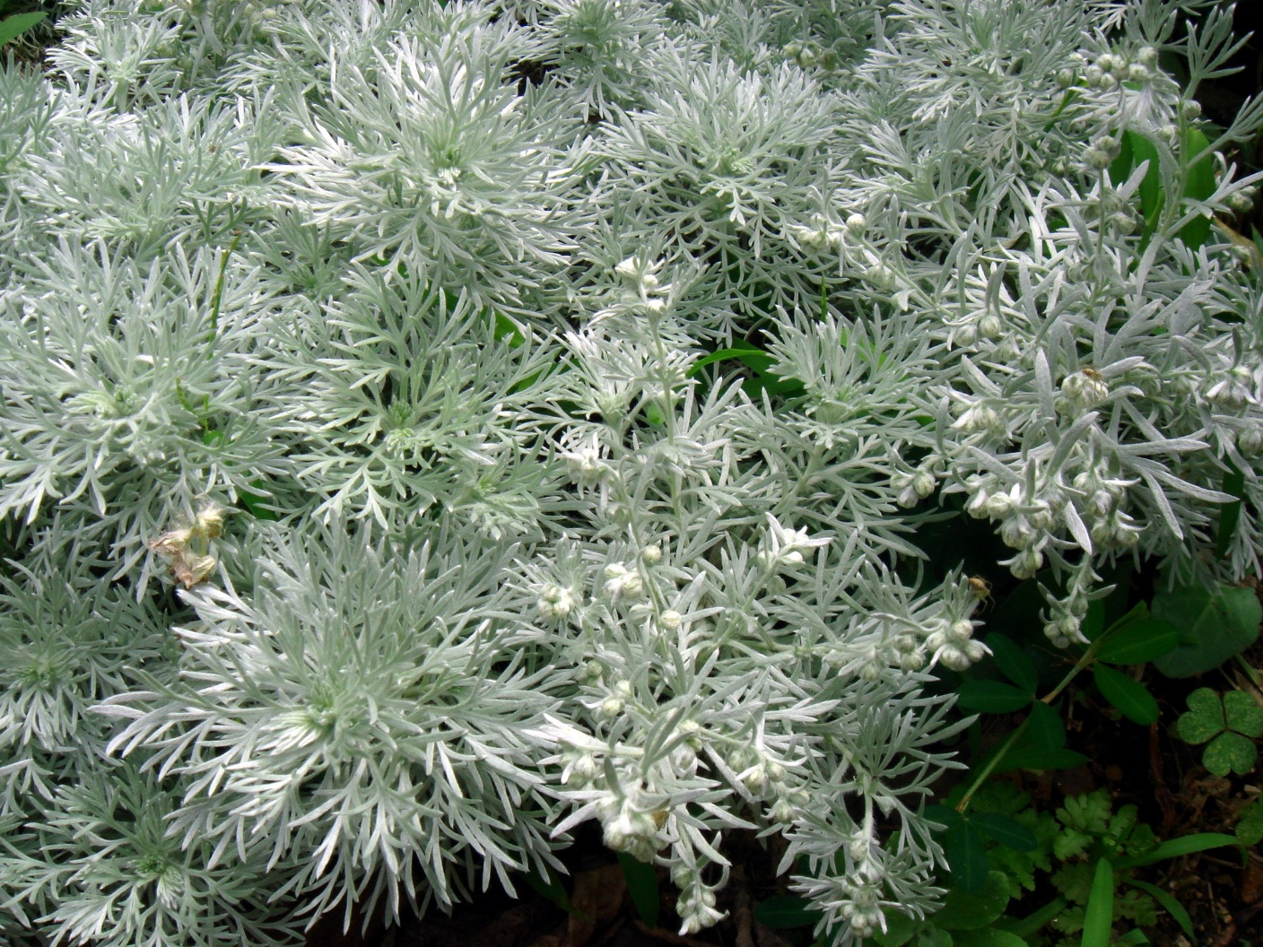

Slide 18
Asparagus densiflorus ‘Sprengeri’

Slide 19
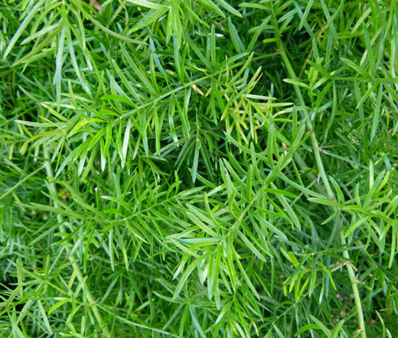
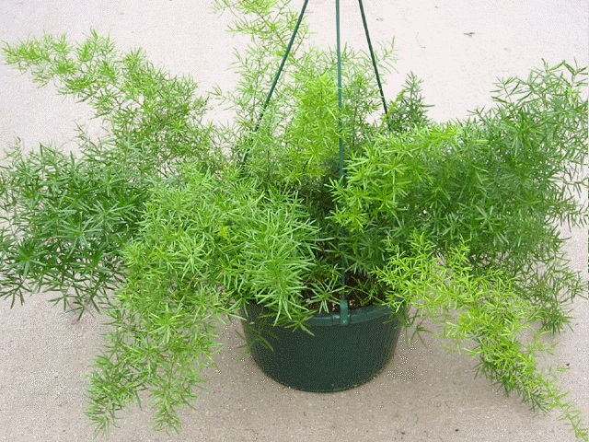

Slide 20
Aster species

Slide 21
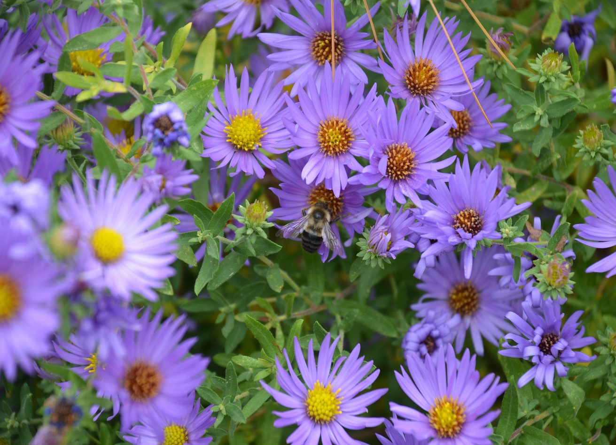
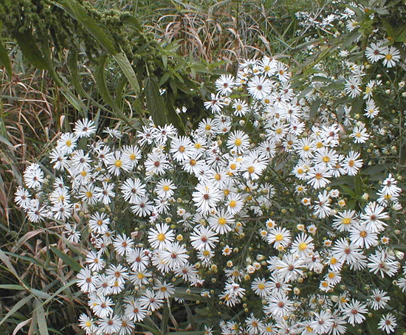

Slide 22
Astilbe hybrid

Slide 23
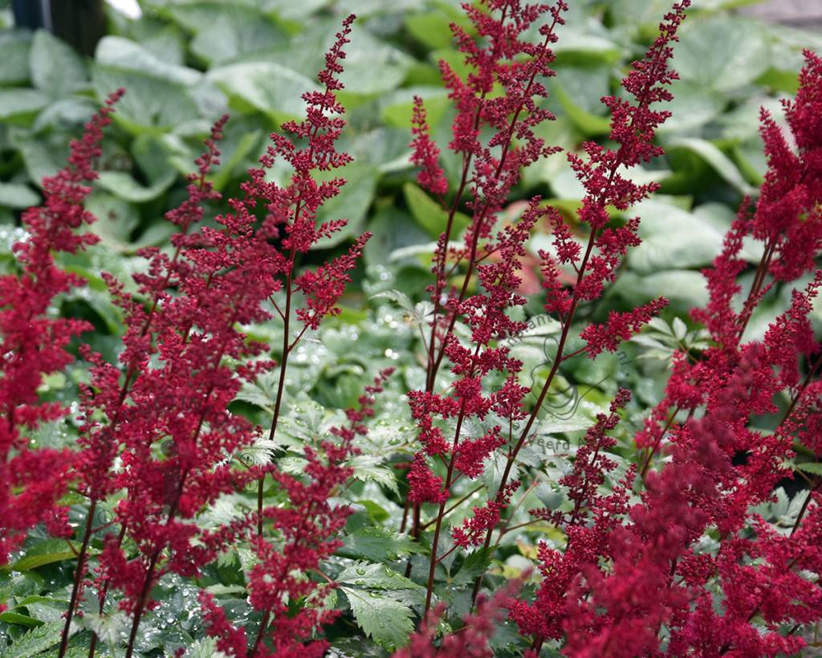
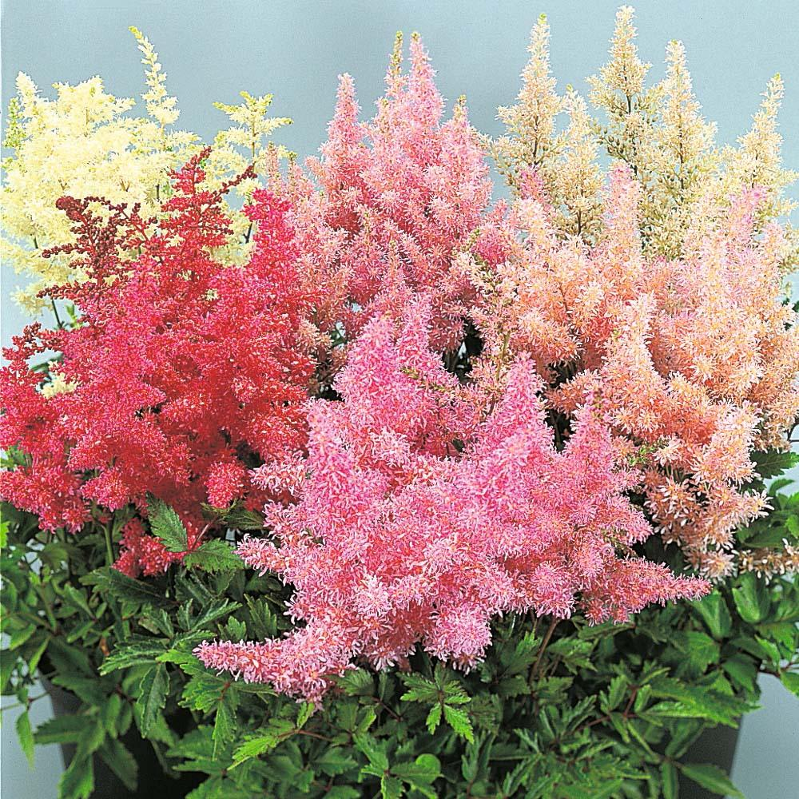

Slide 24
Bacopa monnieri

Slide 25
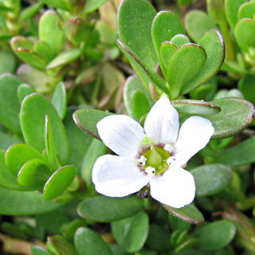
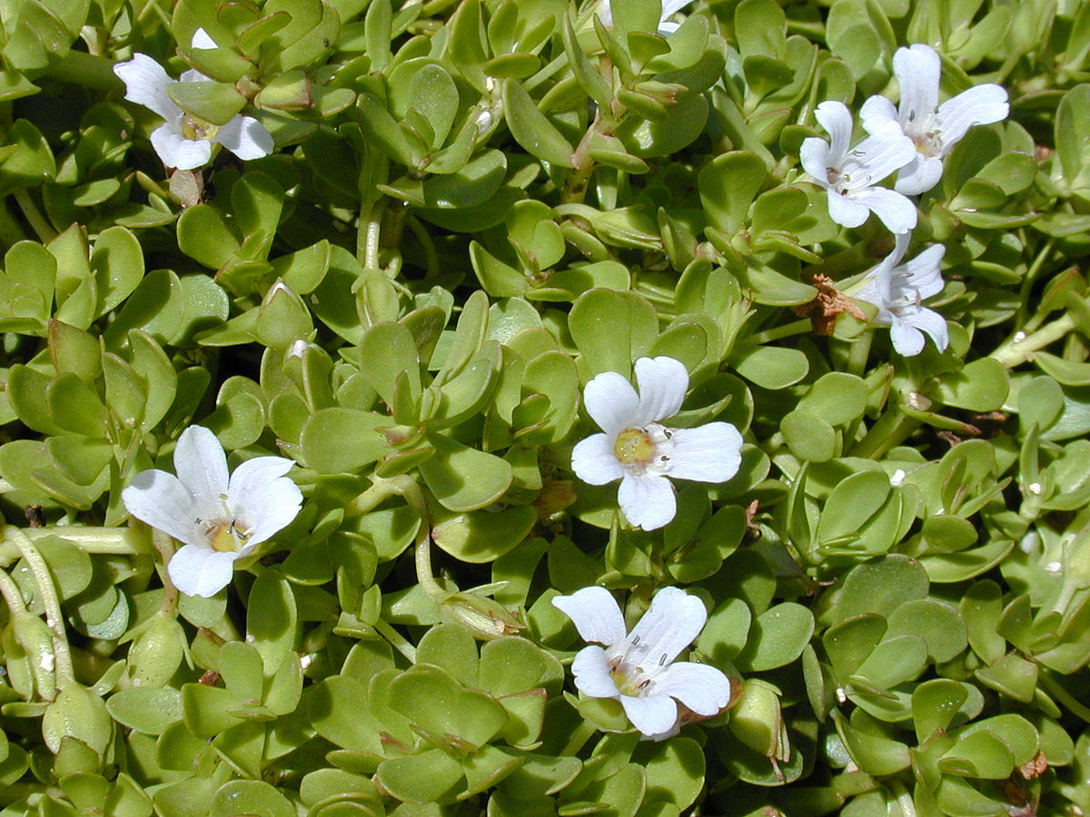

Slide 26
Begonia X semperflorens-cultorum

Slide 27
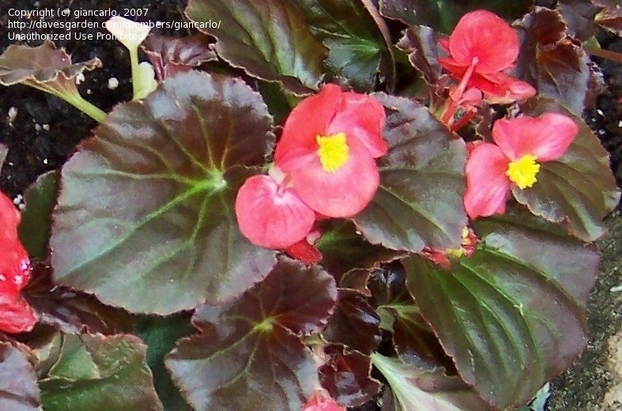
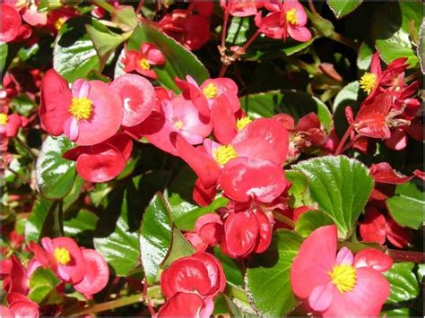

Slide 28
Begonia x tuberhybrida cv.

Slide 29
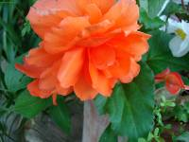
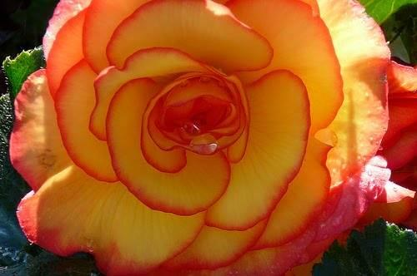
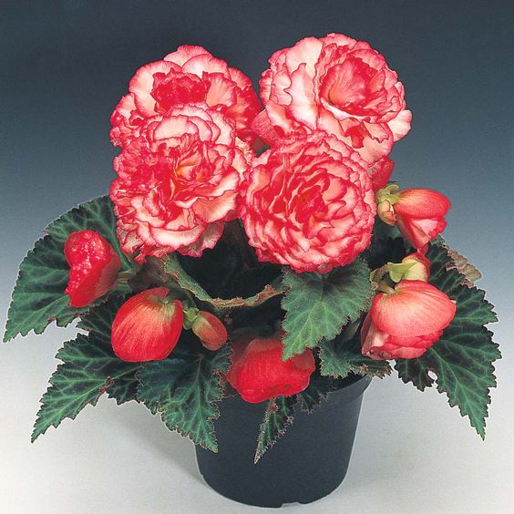

Slide 30
Brassica oleracea var. italic

Slide 31
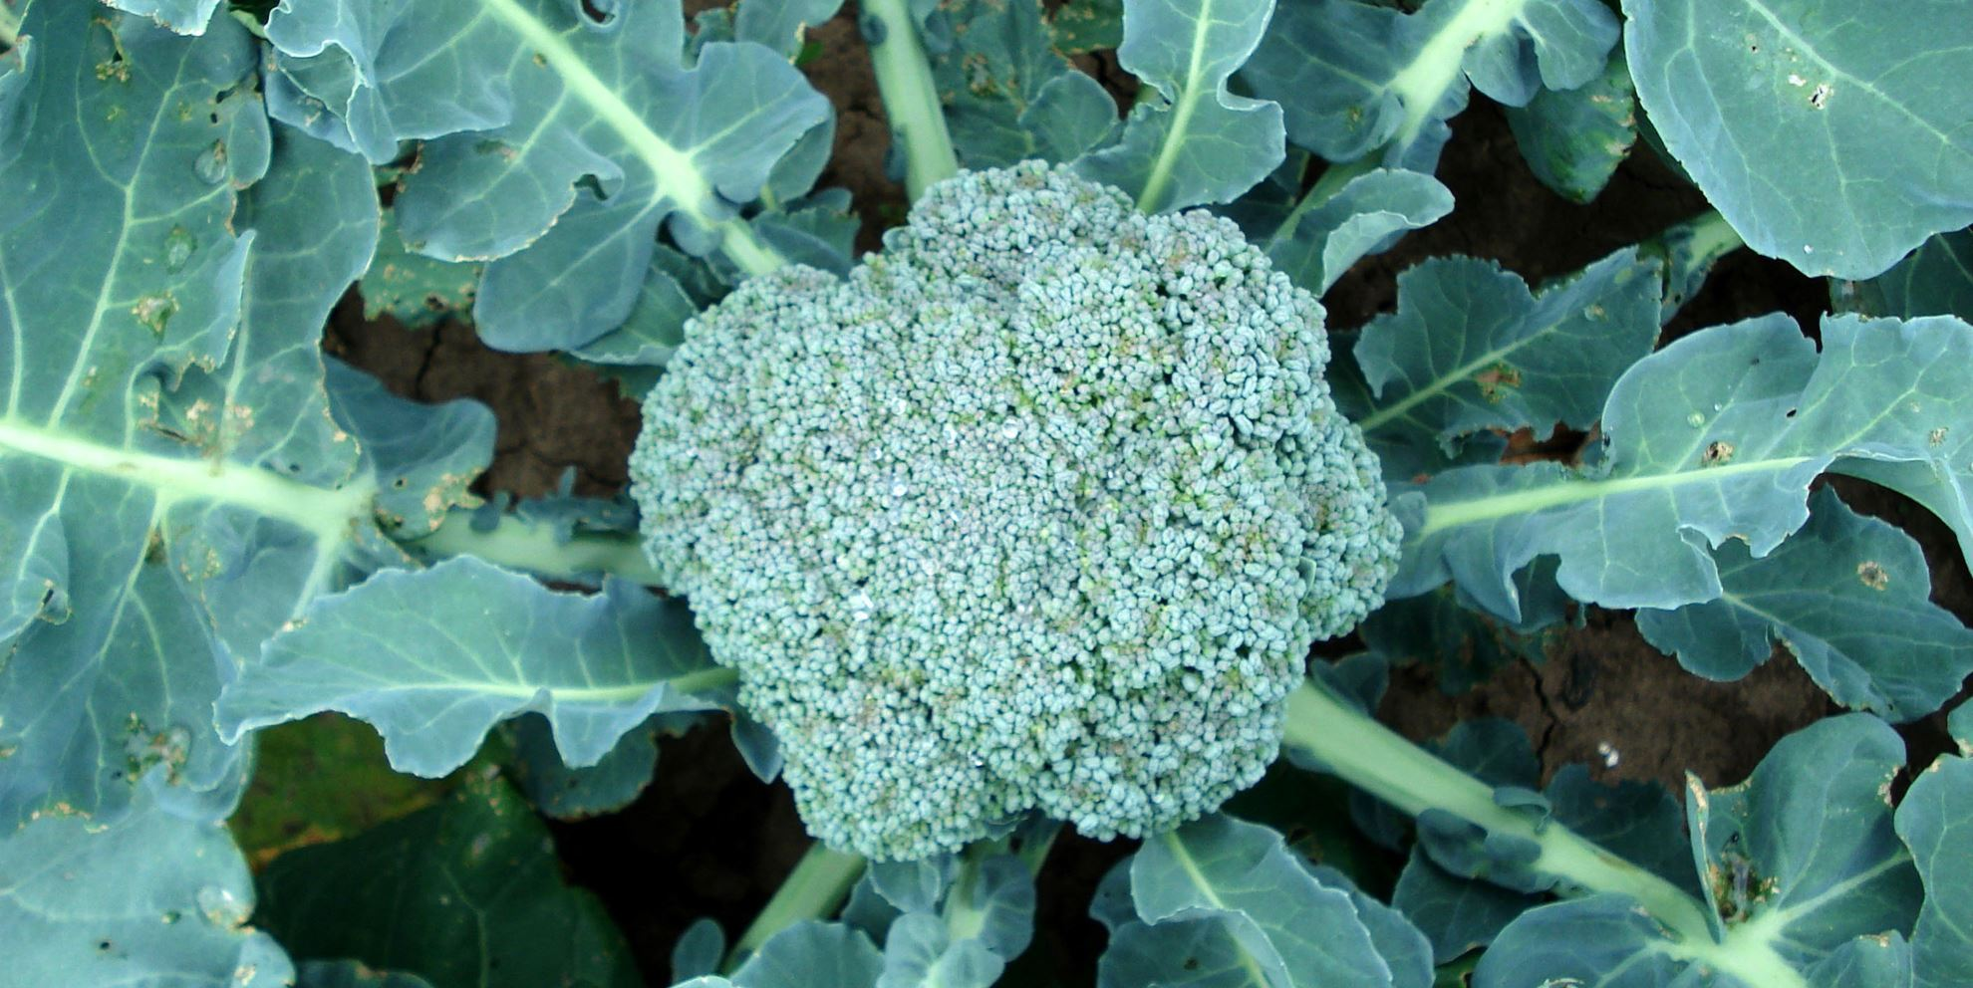
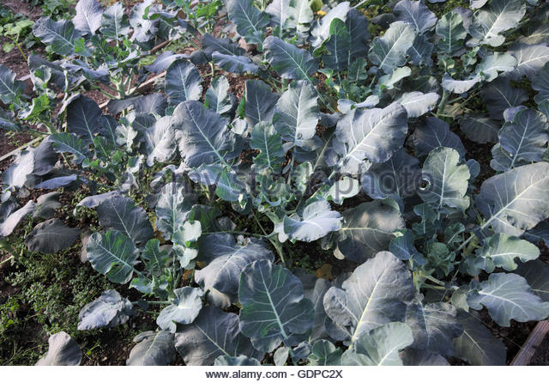
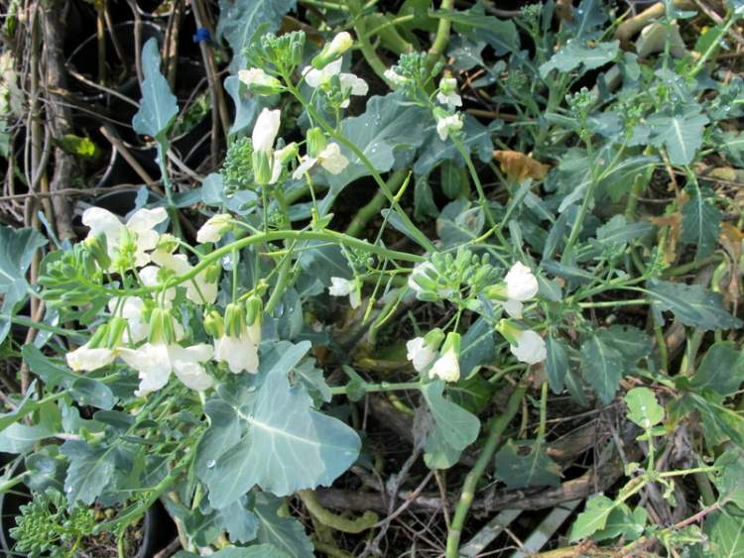

Slide 32
Brassica oleracea var. sabellica

Slide 33
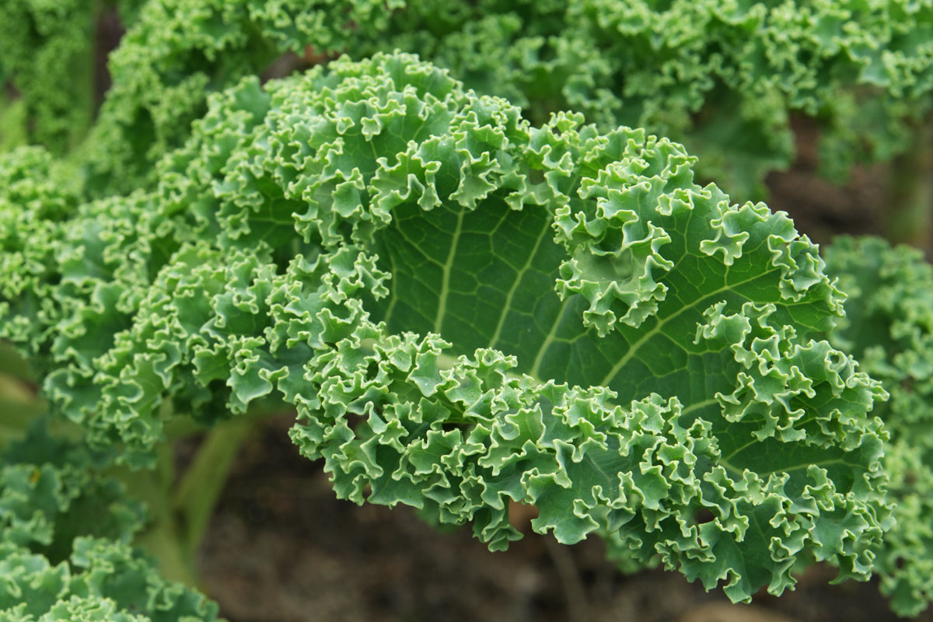
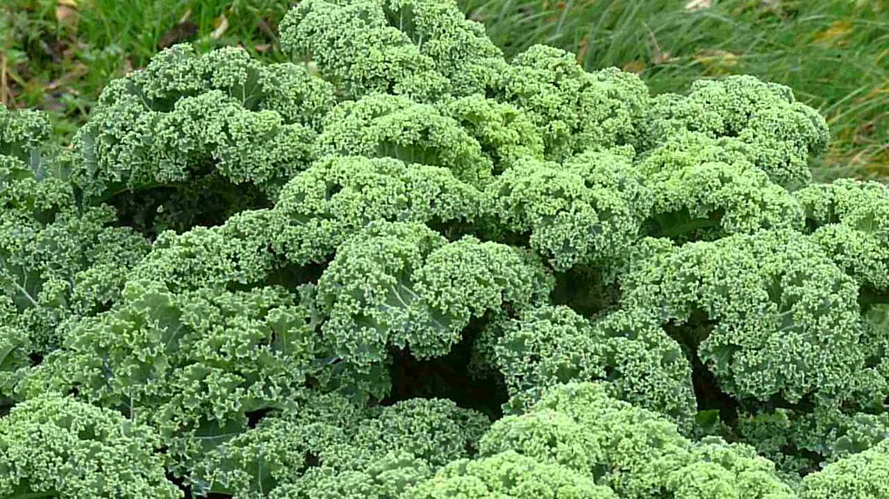

Slide 34
Calibrachoa species

Slide 35
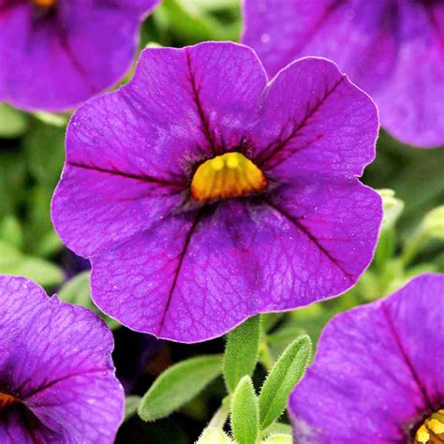
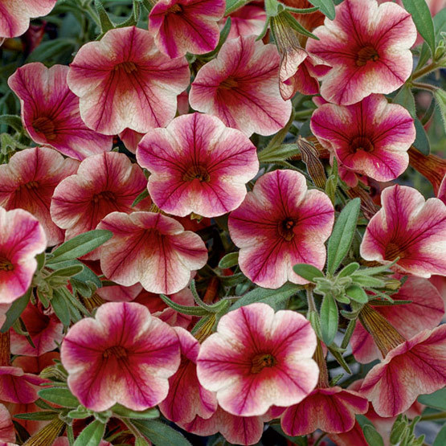
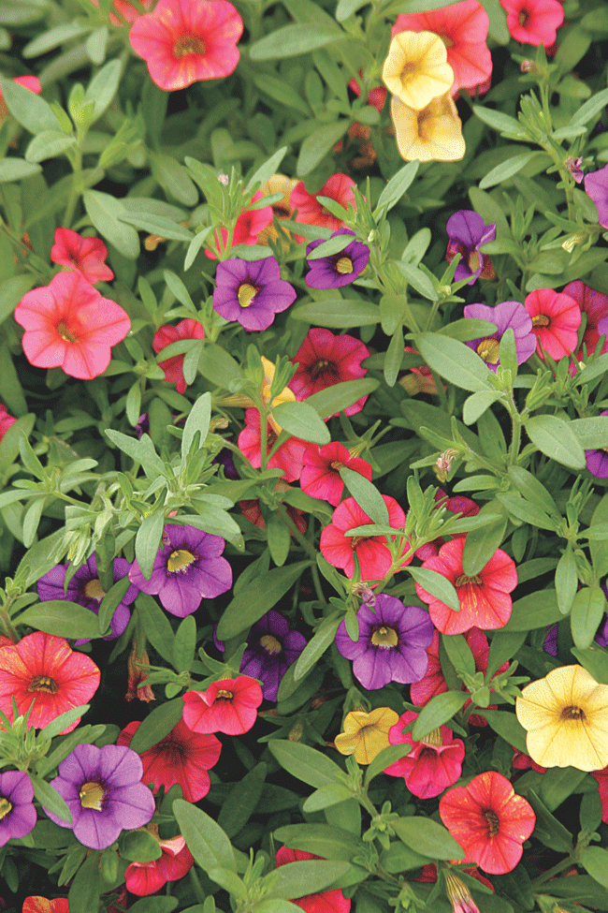

Slide 36
Capsicum annuum

Slide 37
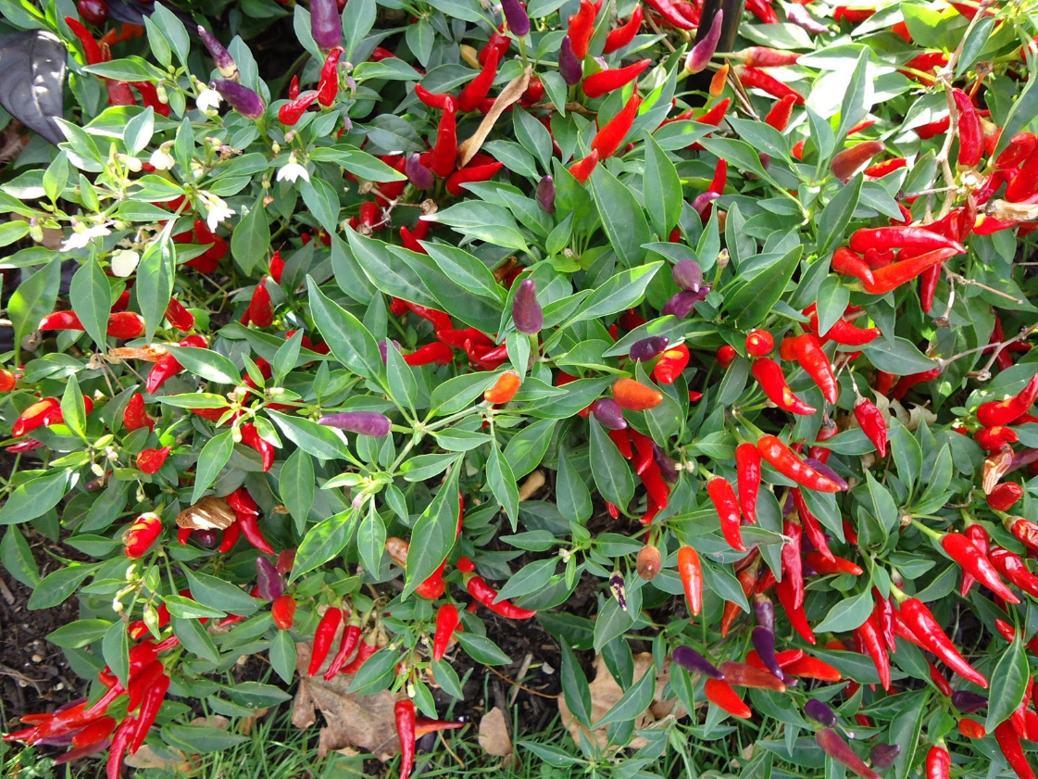
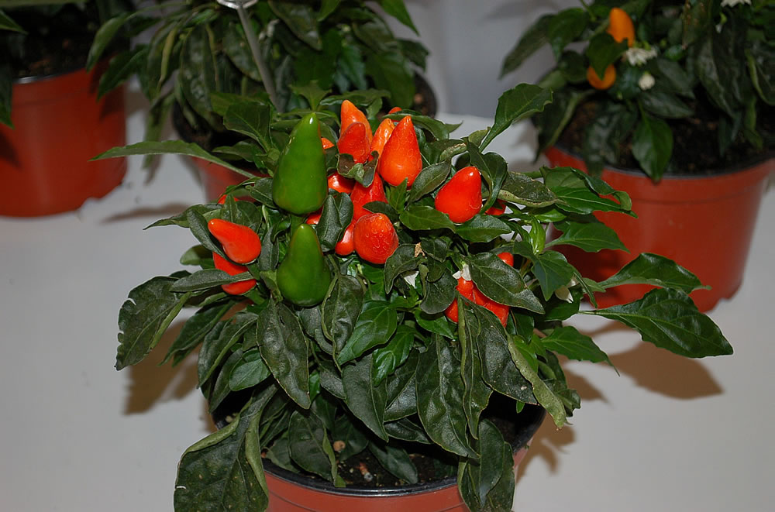
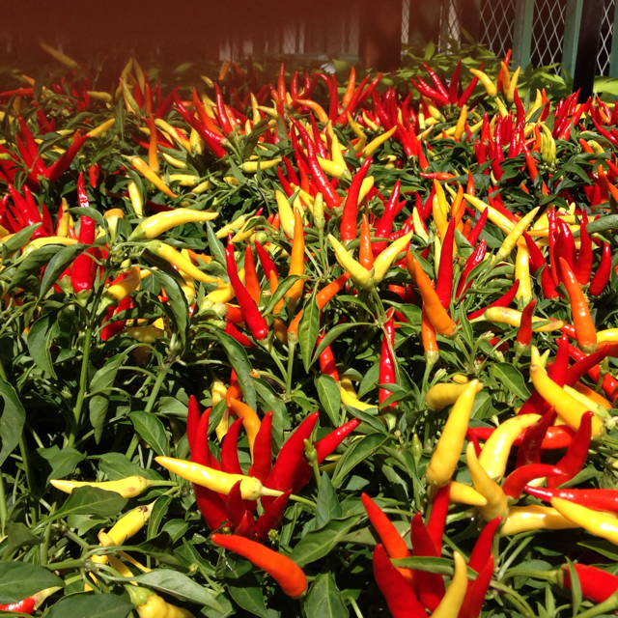

Slide 38
Celosia argentea plumosa

Slide 39
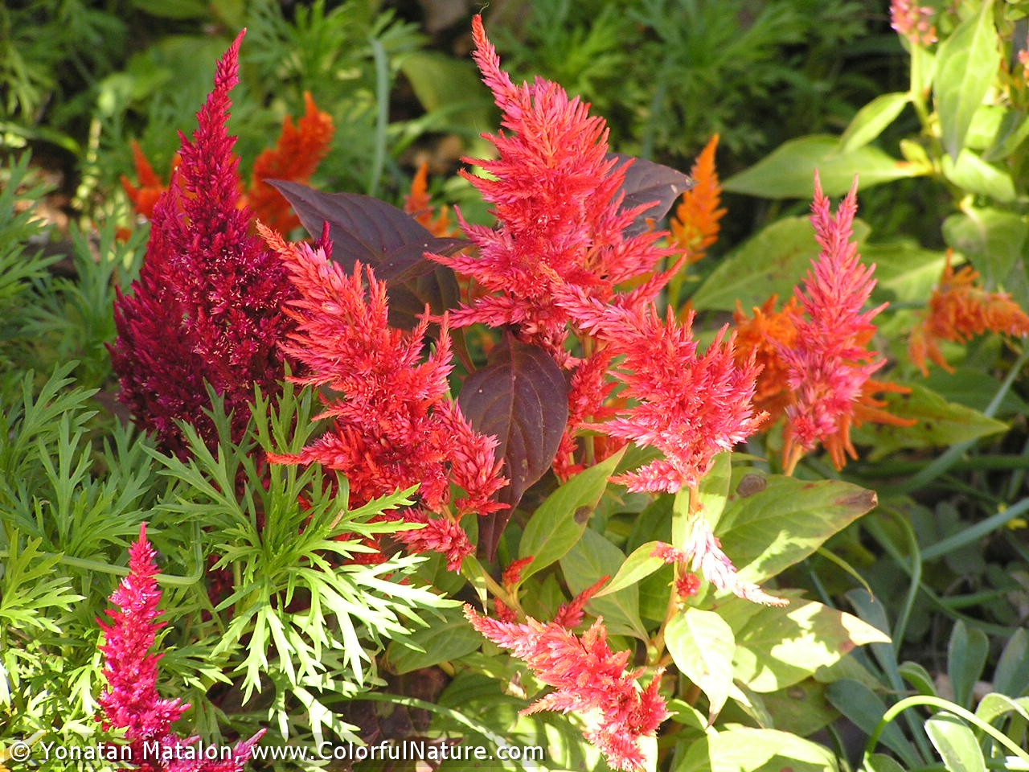
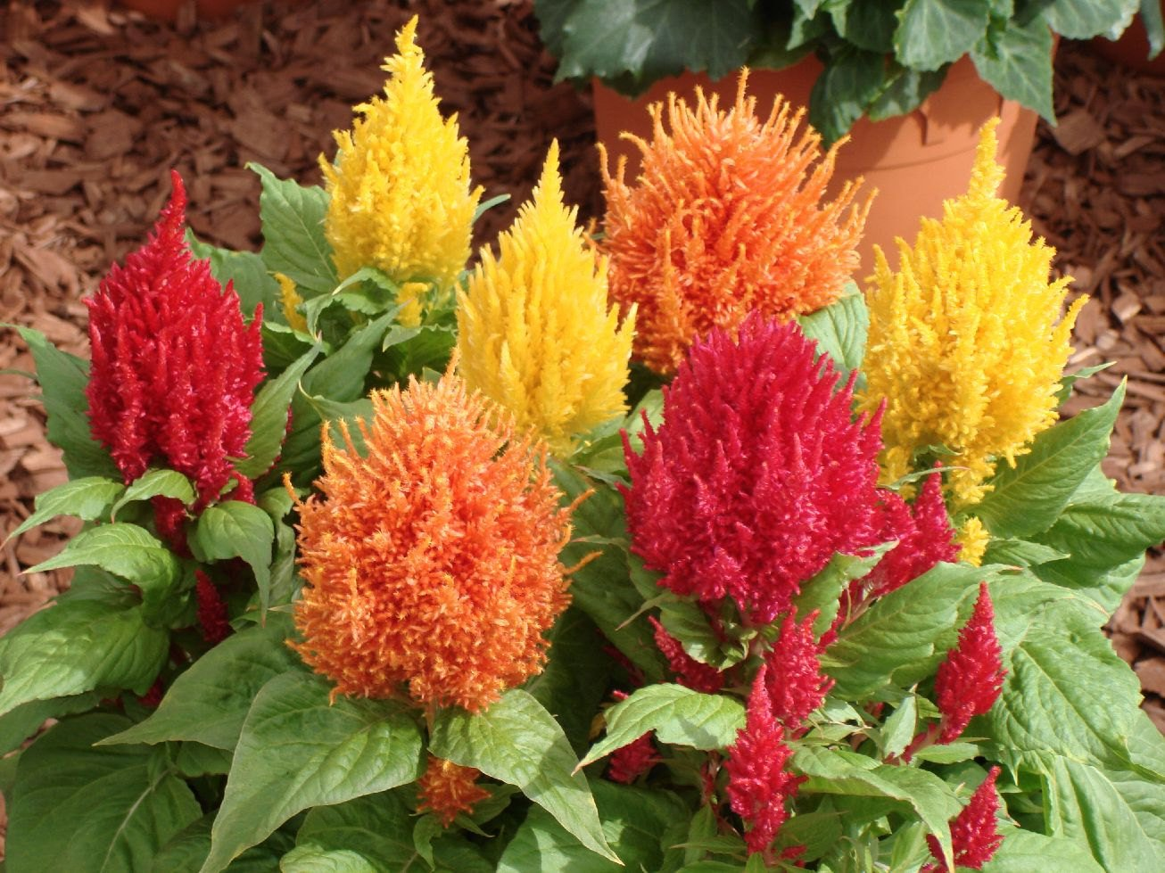

Slide 40
Chrysanthemum x moriflorium cv.

Slide 41
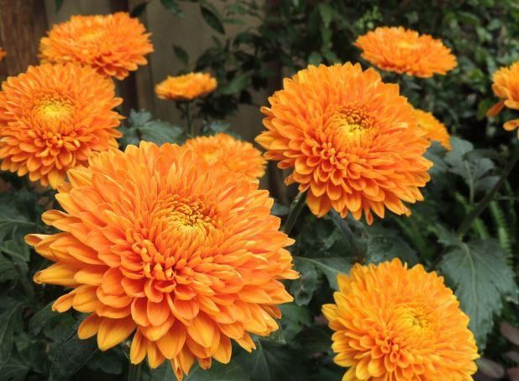
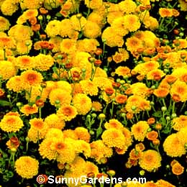

Slide 42
Cleome hassleriana

Slide 43
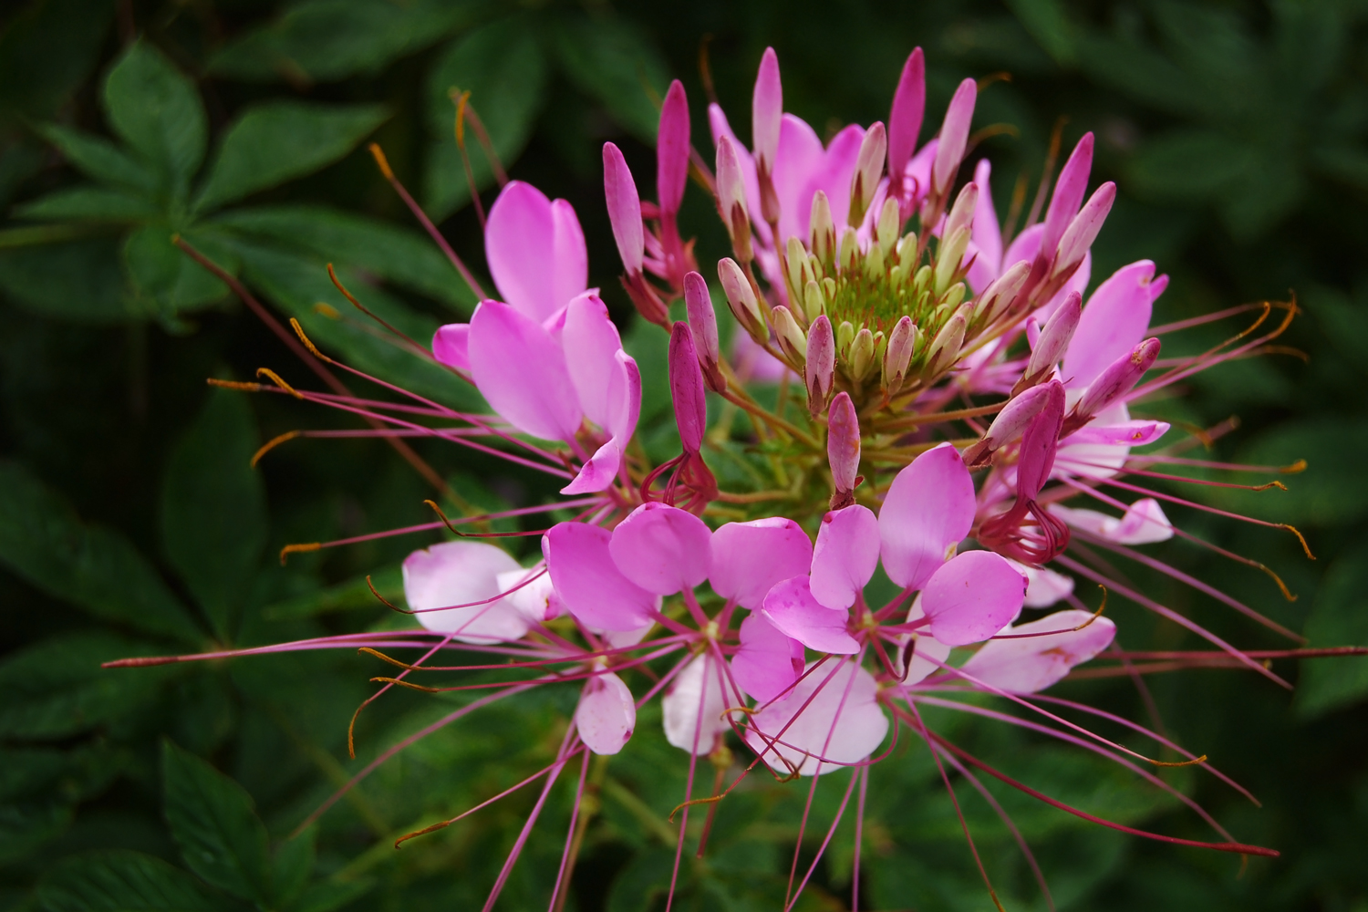
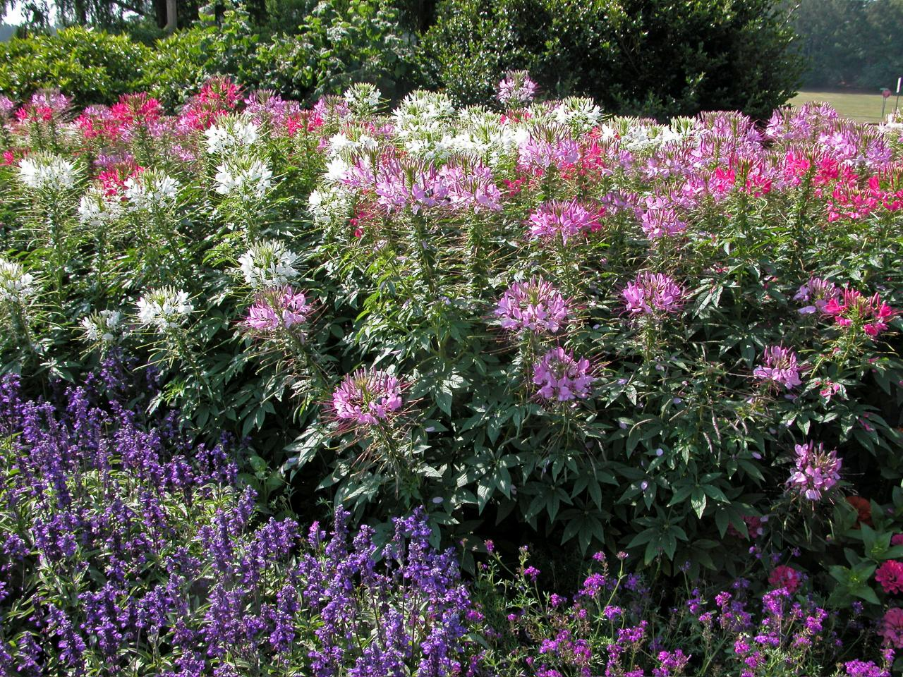

Slide 44
Coleus X hybridus

Slide 45
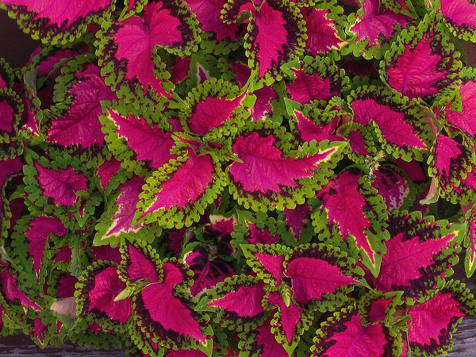

Slide 46
Coreopsis grandiflora

Slide 48
Coriandrum sativum

Slide 50
Cosmos bipinnatus

Slide 52
Crassula argentea

Slide 54
Cyclamen persicum

Slide 56
Cyperus papyrus

Slide 58
Dahlia species

Slide 60
Delphinium x cultorum

Slide 62
Dianthus species

Slide 64
Diascia hybrid

Slide 66
Dieffenbachia maculata

Slide 68
Dracaena deremensis ‘Warneckii”

Slide 70
Dracaena fragrans “Massangeana”

Slide 72
Echeveria species

Slide 74
Echinacea purpurea

Slide 76
Epipremnum aureum

Slide 78
Eruca sativa

Slide 80
Euphorbia pulcherrima

Slide 82
Ficus benjamina

Slide 84
Fragaria x ananassa

Slide 86
Fuchsia magellanica

Slide 88
Gaura oenothera

Slide 90
Gerbera jamesonii

Slide 92
Gladiolus species

Slide 94
Hedera helix

Slide 96
Helianthus annuus

Slide 98
Helichrysum species

Slide 100
Hemerocallis spp.

Slide 102
Heptapleurum arboricola

Slide 104
Heuchera x hybrida

Slide 106
Hosta x hybrida

Slide 108
Hyacinthus orientalis

Slide 110
Impatiens hybrid

Slide 112
Ipomea batatas

Slide 114
Iris x germanica florentina cv.

Slide 116
Kalanchoe blossfeldiana

Slide 118
Lavandula angustifolia

Slide 120
Leucanthemum superbum

Slide 122
Liatris spicata

Slide 124
Lilium longiflorum

Slide 126
Lilium x hybridum cv.

Slide 128
Liriope muscari

Slide 130
Lobularia maritima

Slide 132
Maranta leuconeura var. kerchoviana

Slide 134
Mentha

Slide 136
Miscanthus sinensis

Slide 138
Narcissus pseudonarcissus

Slide 140
Nephrolepis exalt

Slide 142
Ocimum basilicum

Slide 144
Origanum vulgare

Slide 146
osteospermum

Slide 148
Oxalis articulata

Slide 150
Paeonia sp.

Slide 152
Pelargonium peltatum

Slide 154
Pelargonium X hortorum

Slide 156
Pennisetum setaceum ‘Rubrum’

Slide 158
Perovskia atriplicifolia

Slide 160
Petroselinum crispum

Slide 162
Petunia X hybrida

Slide 164
Phalaenopsis

Slide 166
Phaseolus vulgaris

Slide 168
Rosa spp. Class Hybrid Tea

Slide 170
Rosmarinus officinalis

Slide 172
Rudbeckia fulgida

Slide 174
Saintpaulia ionantha

Slide 176
Salvia nemorosa

Slide 178
Schlumbergera truncata

Slide 180
Sedum species

Slide 182
Solanum lycopersicum

Slide 184
Solanum melongena

Slide 186
Spathiphyllum floribundum

Slide 188
Spinacia oleracea

Slide 190
Strobilanthes atropurpureus

Slide 192
Tagetes spp.

Slide 194
Thymus vulgaris

Slide 196
Tulipa spp.

Slide 198
Verbena stricta

Slide 200
Vinca minor

Slide 202
Viola wittrockiana

Slide 204
Zebrina pendula

Slide 206
Zinnia elegans

