Slide 1
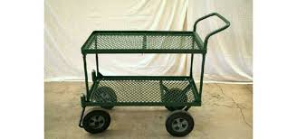

Slide 2
Cart/Wagon

Slide 4
Cart/Wagon

Slide 6
Cart/Wagon

Slide 8
Circulation Fan

Slide 10
Circulation Fan

Slide 12
Circulation Fan

Slide 14
Dome Lid

Slide 16
Dome Lid

Slide 18
Dome Lid

Slide 20
Drip Tube

Slide 22
Drip Tube

Slide 24
Drip Tube

Slide 26
Ebb and Flow Irrigation

Slide 28
Ebb and Flow Irrigation

Slide 30
Ebb and Flow Irrigation

Slide 32
Exhaust Fan

Slide 34
Exhaust Fan

Slide 36
Exhaust Fan

Slide 38
Fertilizer Injector

Slide 40
Fertilizer Injector

Slide 42
Fertilizer Injector

Slide 44
Float System

Slide 46
Float System

Slide 48
Float System

Slide 50
Flood Table

Slide 52
Flood Table

Slide 54
Flood Table

Slide 55
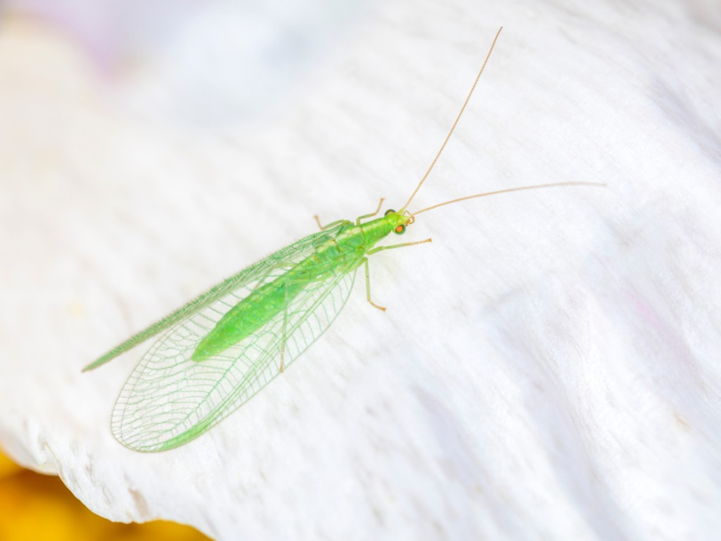

Slide 56
Green Lacewing

Slide 57
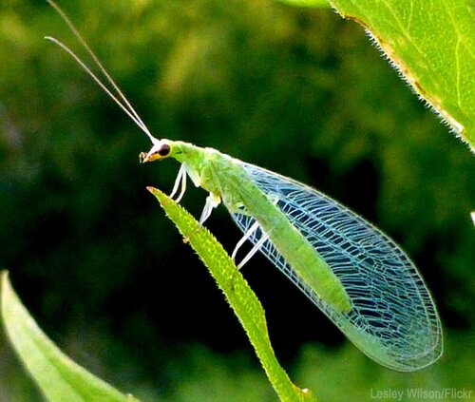

Slide 58
Green Lacewing

Slide 59
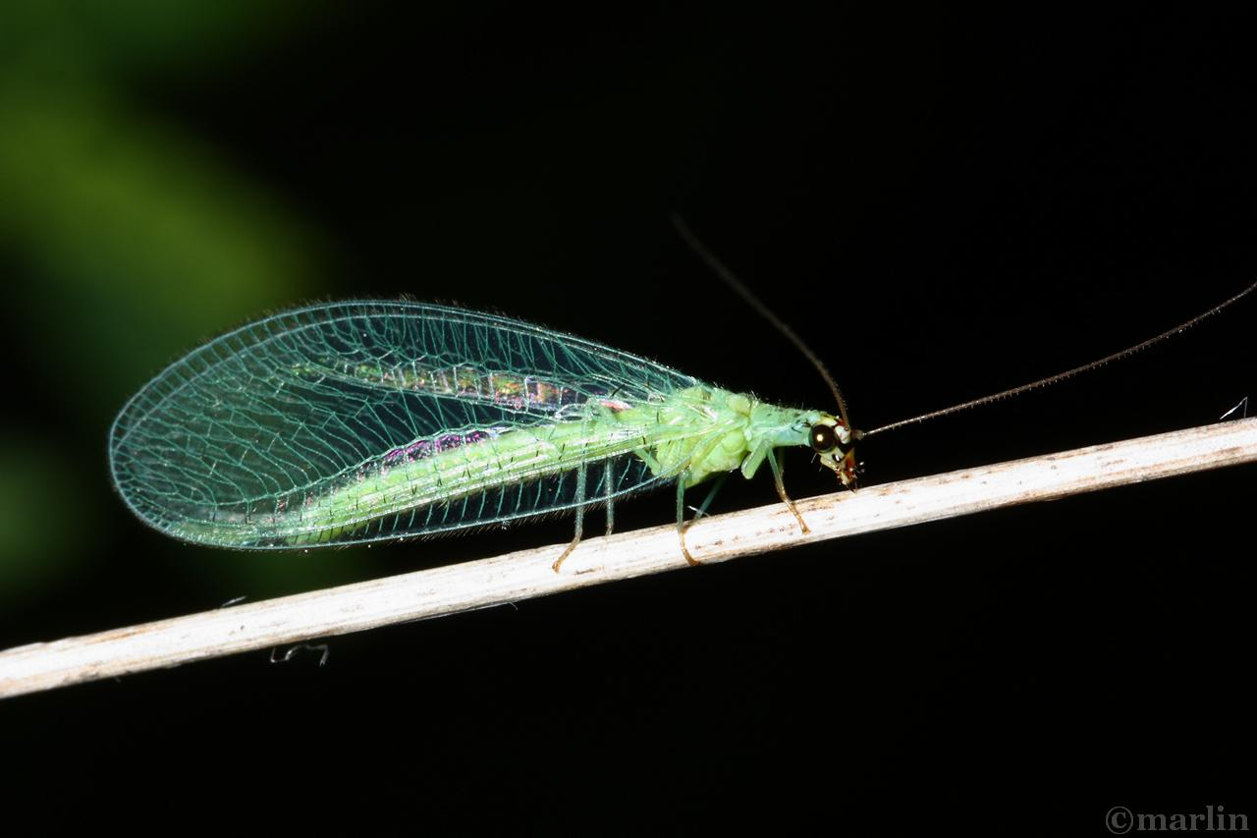

Slide 60
Green Lacewing

Slide 61
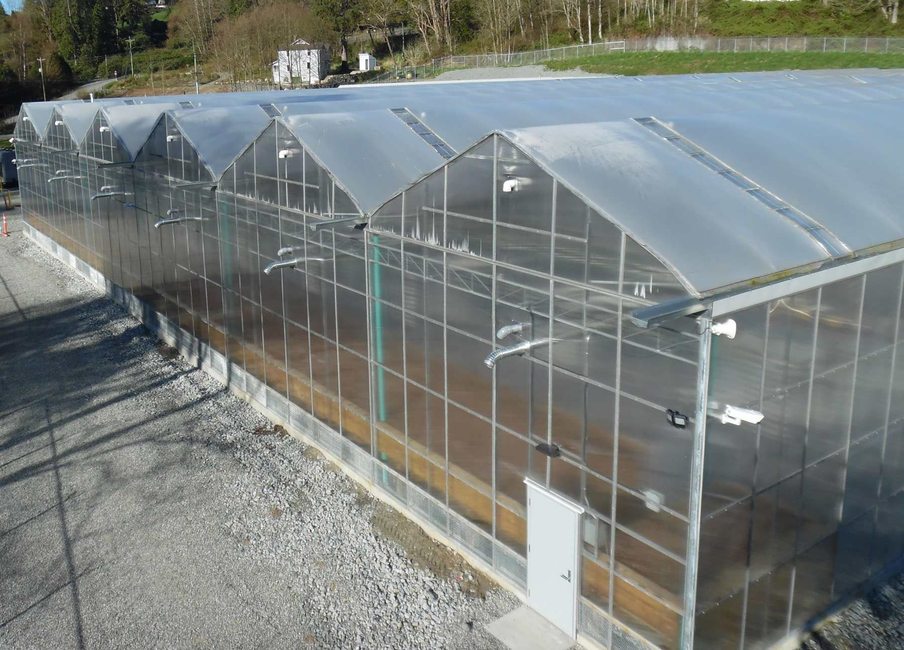

Slide 62
Gutter Connected
Greenhouse

Slide 63
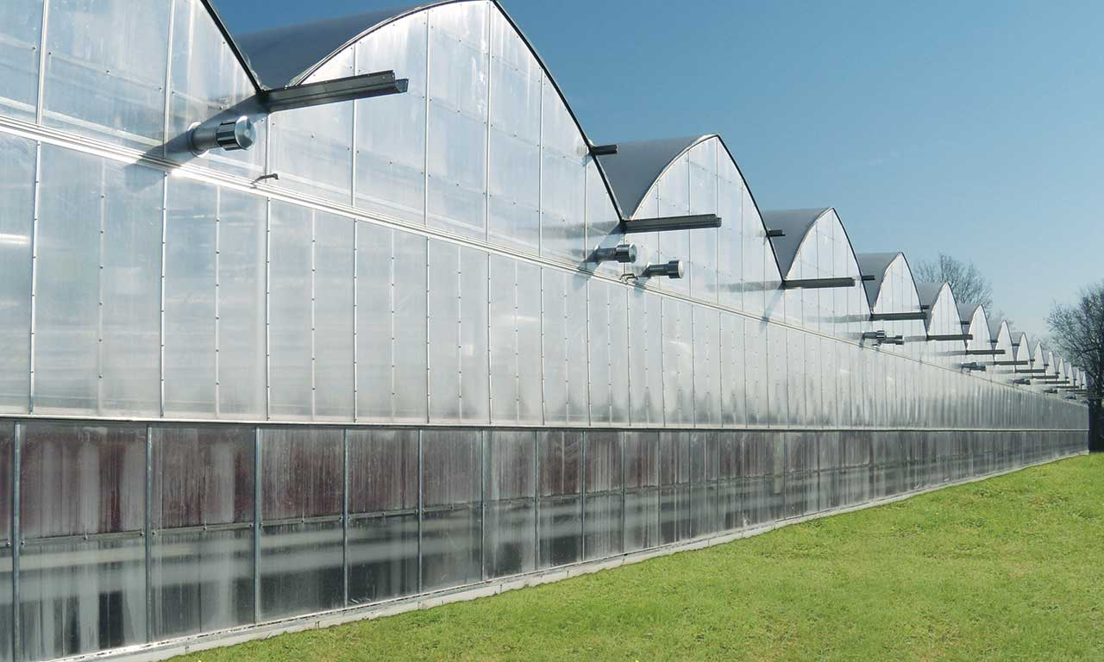

Slide 64
Gutter Connected
Greenhouse

Slide 65
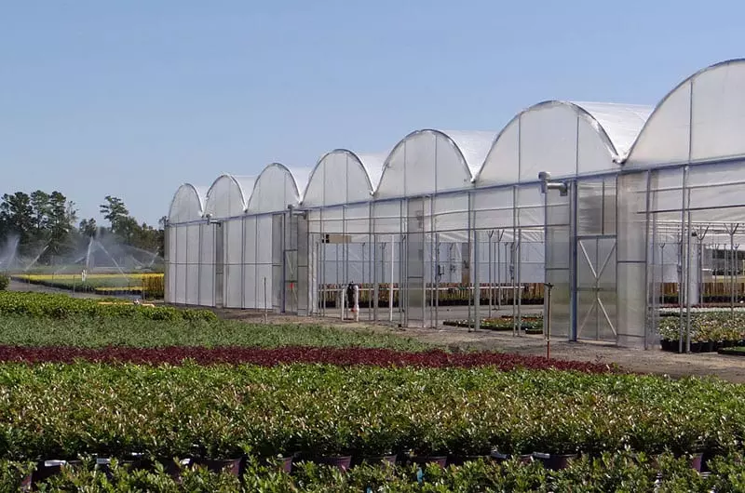

Slide 66
Gutter Connected
Greenhouse

Slide 68
Heat Mat

Slide 70
Heat Mat

Slide 72
Heat Mat

Slide 74
High Tunnel

Slide 76
Hoop House

Slide 78
Hoop House

Slide 80
Hoop House

Slide 82
¾” Hose

Slide 84
¾” Hose

Slide 86
¾” Hose

Slide 88
Irrigation Controller

Slide 90
Irrigation Controller

Slide 92
Irrigation Controller

Slide 93
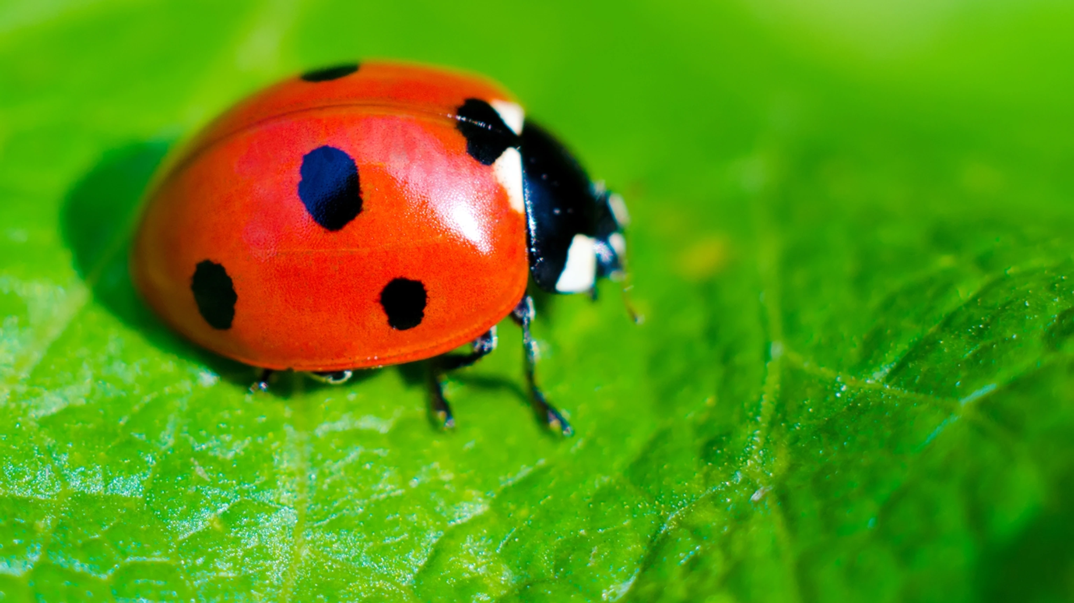

Slide 94
Lady Bug

Slide 96
Lady Bug

Slide 97
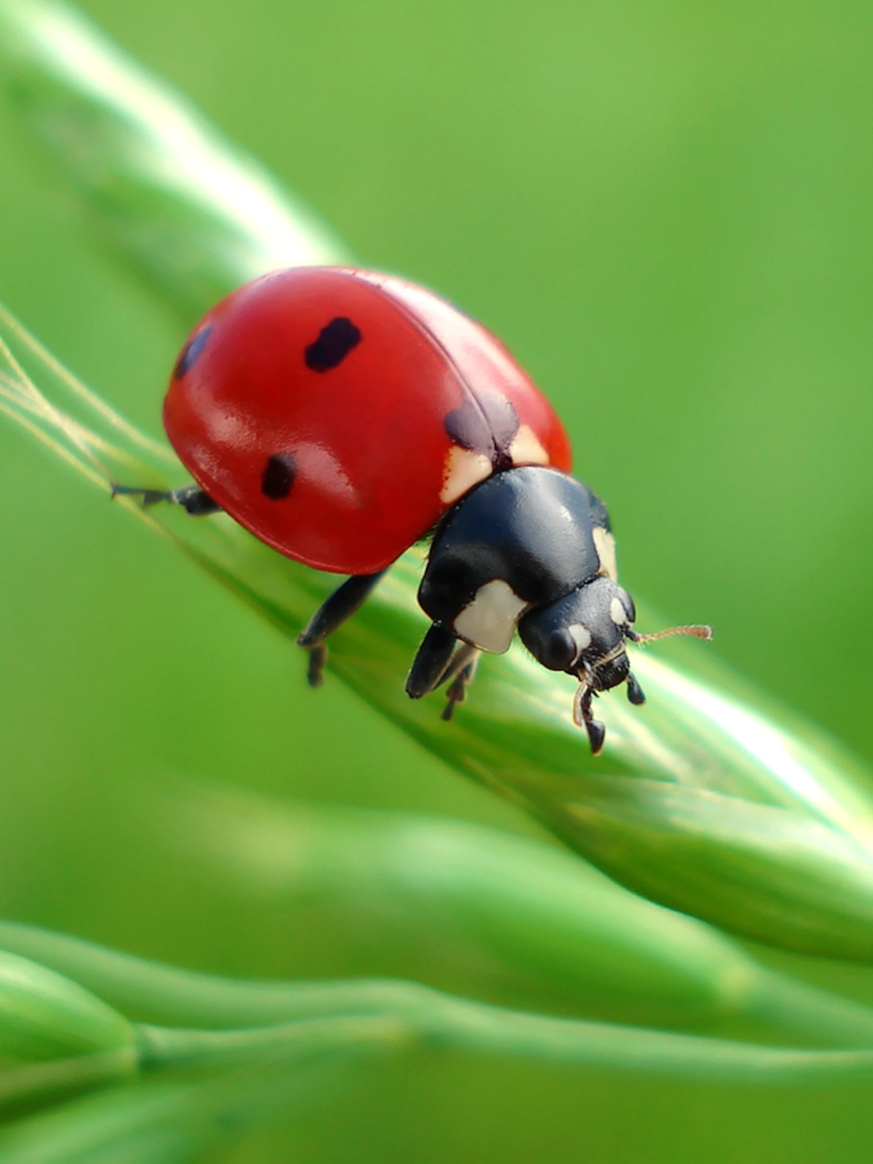

Slide 98
Lady Bug

Slide 100
LED Light

Slide 102
LED Light

Slide 104
LED Light

Slide 106
NFT System

Slide 108
NFT System

Slide 110
NFT System

Slide 111
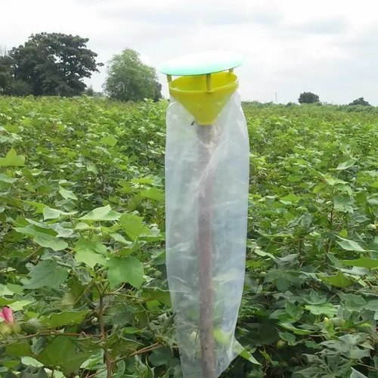

Slide 112
Pheromone Trap

Slide 113
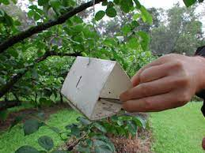

Slide 114
Pheromone Trap

Slide 115
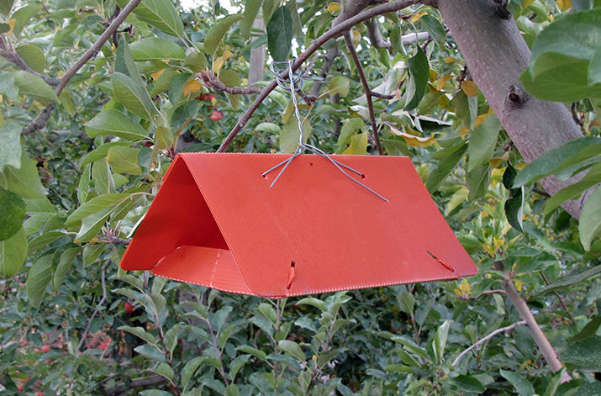

Slide 116
Pheromone Trap

Slide 118
Polyethylene Film

Slide 120
Polyethylene Film

Slide 122
Polyethylene Film

Slide 124
Polyethylene Tubing

Slide 126
Polyethylene Tubing

Slide 128
Polyethylene Tubing

Slide 130
Peat

Slide 132
Peat

Slide 134
Peat

Slide 136
Perlite

Slide 138
Perlite

Slide 140
Perlite

Slide 142
Pesticide Sprayer

Slide 144
Pesticide Sprayer

Slide 146
Pesticide Sprayer

Slide 148
Polycarbonate

Slide 150
Polycarbonate

Slide 152
Polycarbonate

Slide 154
Pruners

Slide 156
Pruners

Slide 158
Pruners

Slide 160
Rock Wool

Slide 162
Rock Wool

Slide 164
Rock Wool

Slide 166
Roof Vent

Slide 168
Roof Vent

Slide 170
Roof Vent

Slide 172
Reservoir Tank

Slide 174
Reservoir Tank

Slide 176
Reservoir Tank

Slide 178
Shade Cloth

Slide 180
Shade Cloth

Slide 182
Shade Cloth

Slide 184
Shuttle Tray

Slide 186
Shuttle Tray

Slide 188
Shuttle Tray

Slide 190
Solar Panel

Slide 192
Solar Panel

Slide 194
Solar Panel

Slide 195
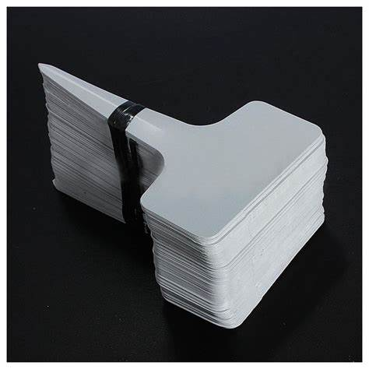

Slide 196
Tags

Slide 197
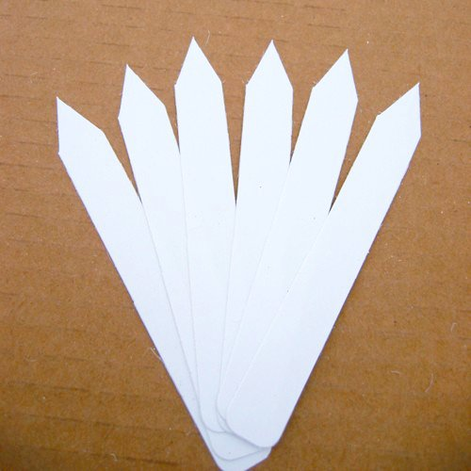

Slide 198
Tags

Slide 199
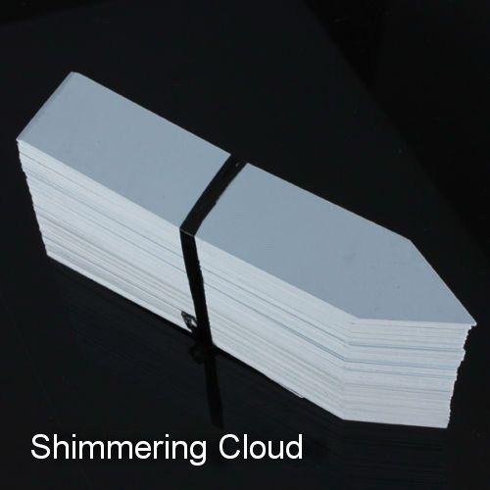

Slide 200
Tags

Slide 202
Thermostat

Slide 204
Thermostat

Slide 206
Thermostat

Slide 208
Vermiculite

Slide 210
Vermiculite

Slide 212
Vermiculite

Slide 213
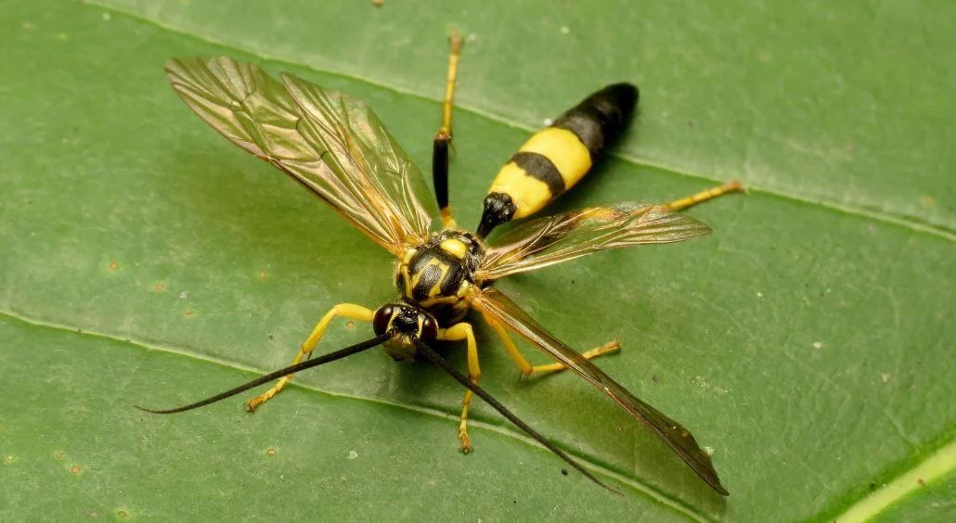

Slide 214
Wasp

Slide 215
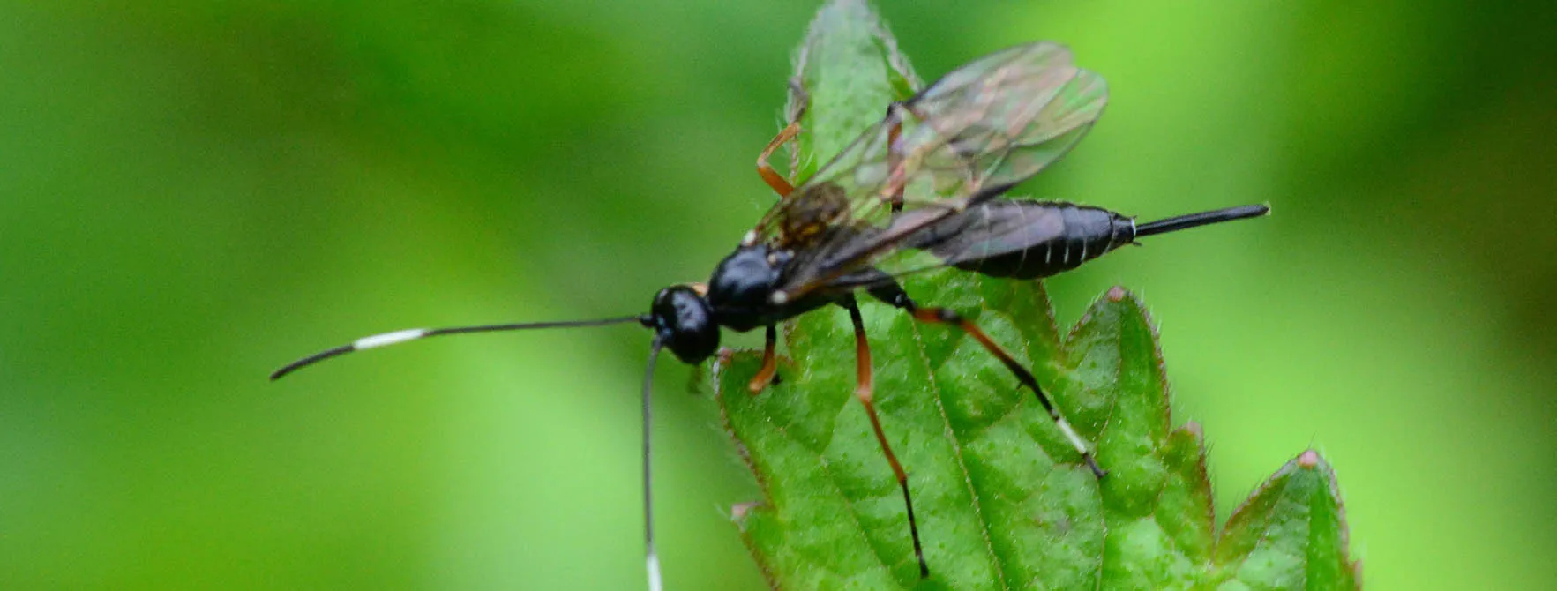

Slide 216
Wasp

Slide 217
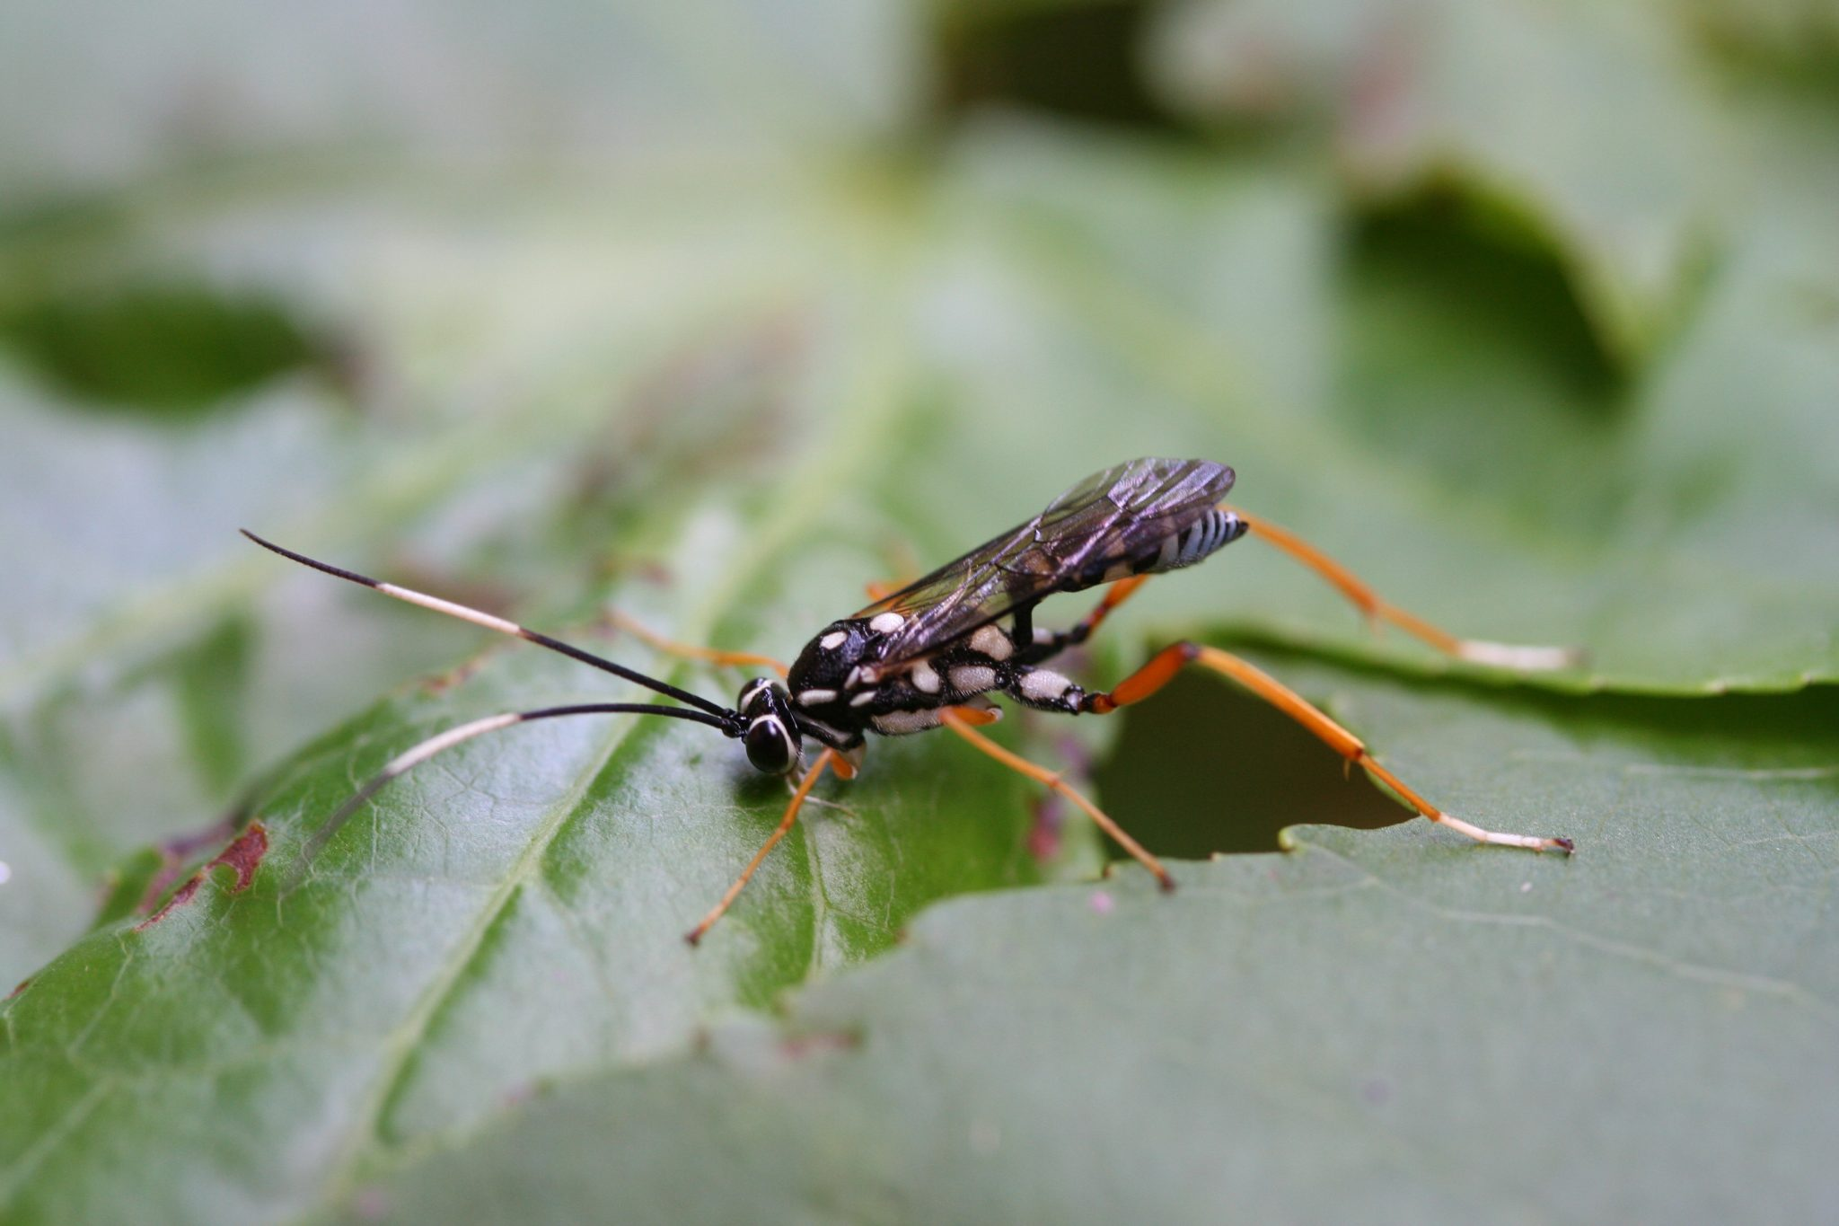

Slide 218
Wasp

Slide 220
Water Pump

Slide 222
Water Pump

Slide 224
Water Pump

Slide 226
Watering Wand

Slide 228
Watering Wand

Slide 230
Watering Wand

Slide 231
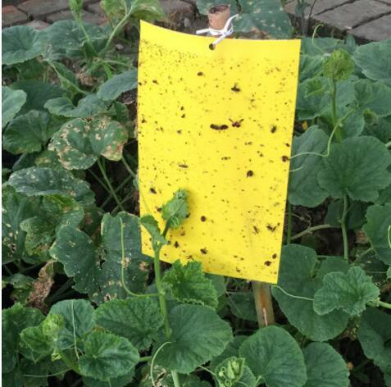

Slide 232
Yellow Sticky Board

Slide 233
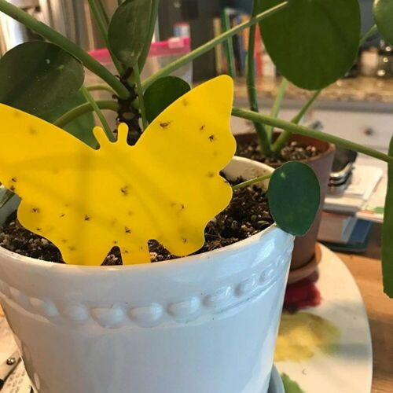

Slide 234
Yellow Sticky Board

Slide 235
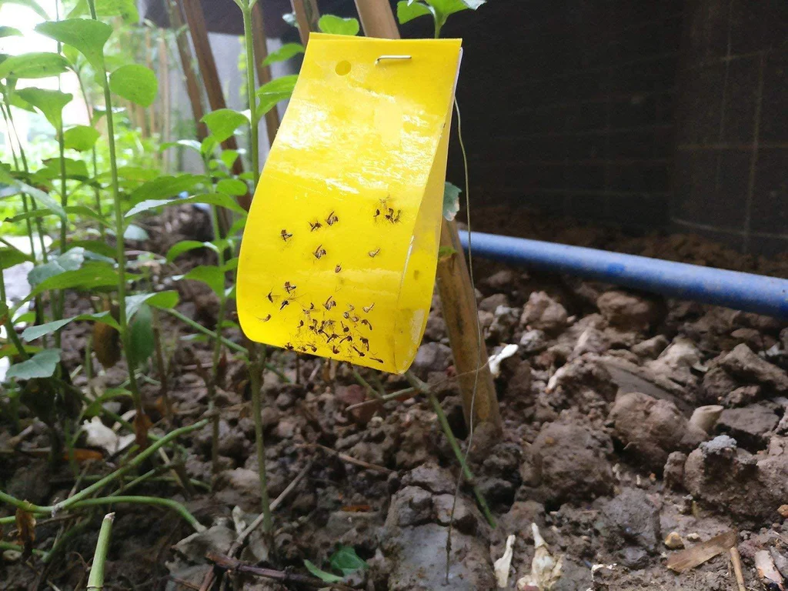

Slide 236
Yellow Sticky Board

