Slide 1
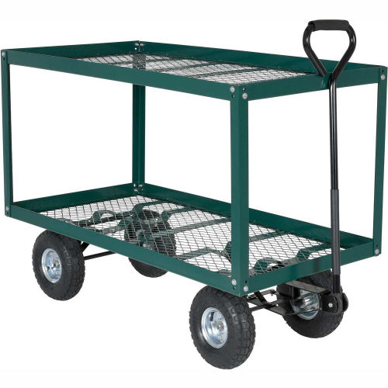

Slide 2
Cart/Wagon

Slide 3
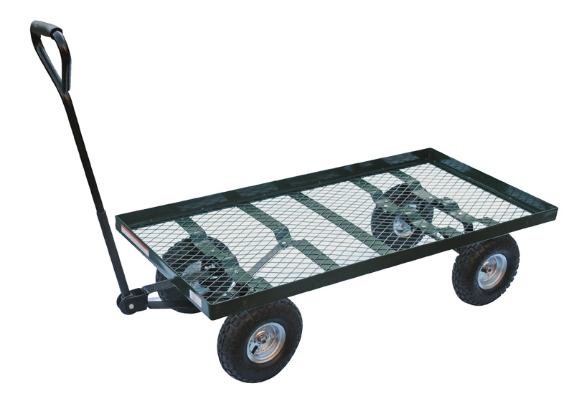

Slide 4
Cart/Wagon

Slide 5
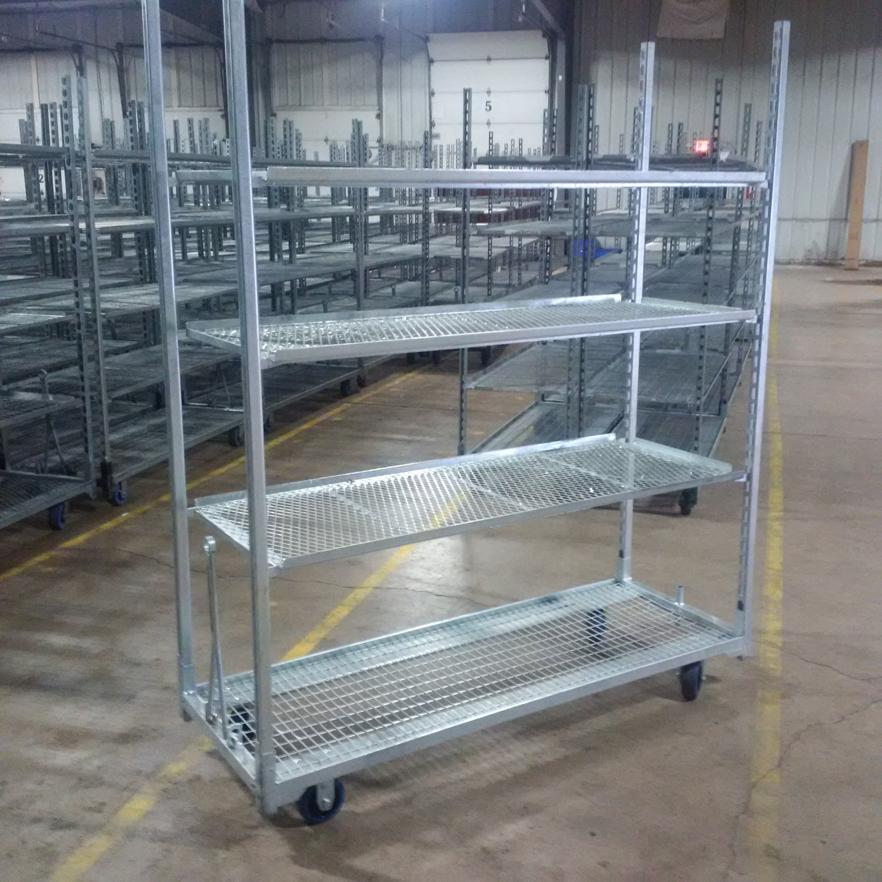

Slide 6
Cart/Wagon

Slide 8
Circulation Fan

Slide 9
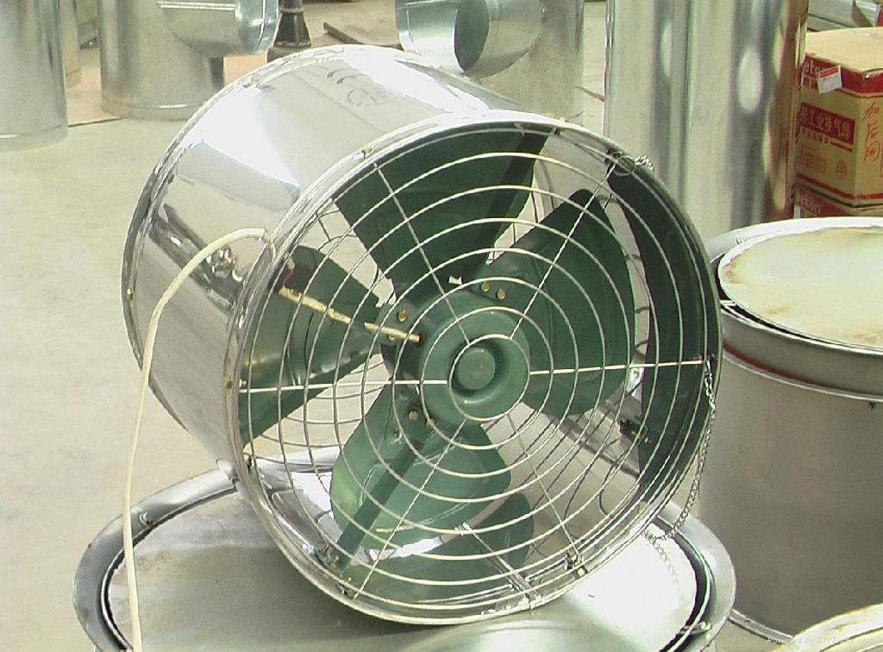

Slide 10
Circulation Fan

Slide 11
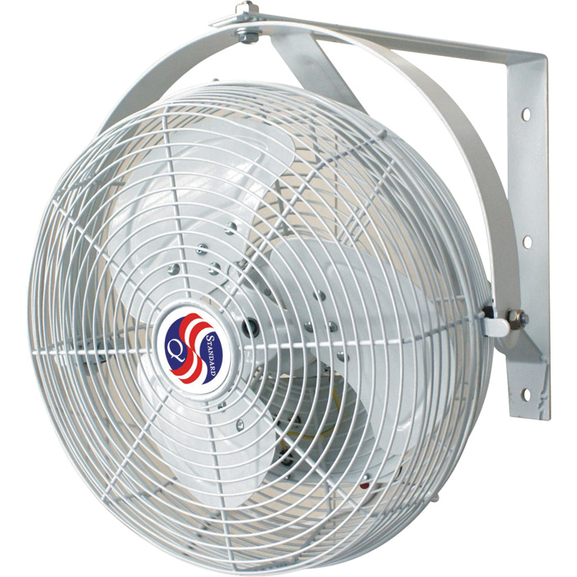

Slide 12
Circulation Fan

Slide 13
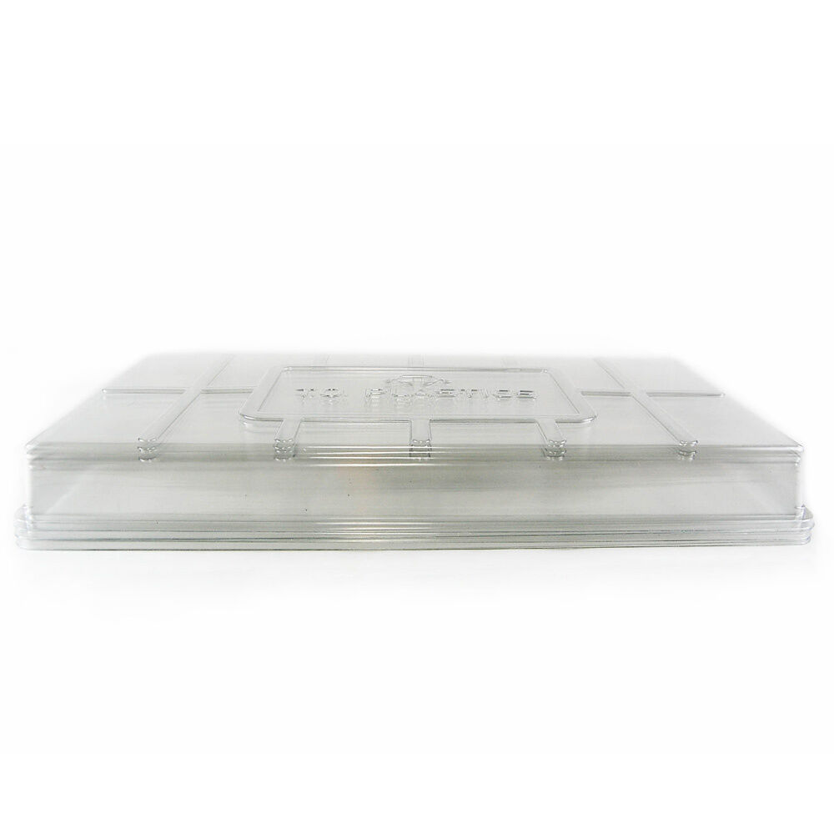
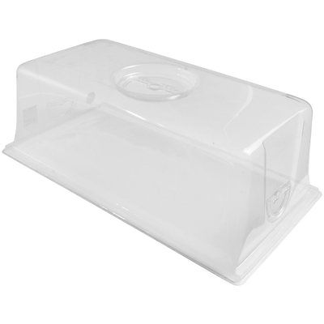

Slide 14
Dome Lid

Slide 15
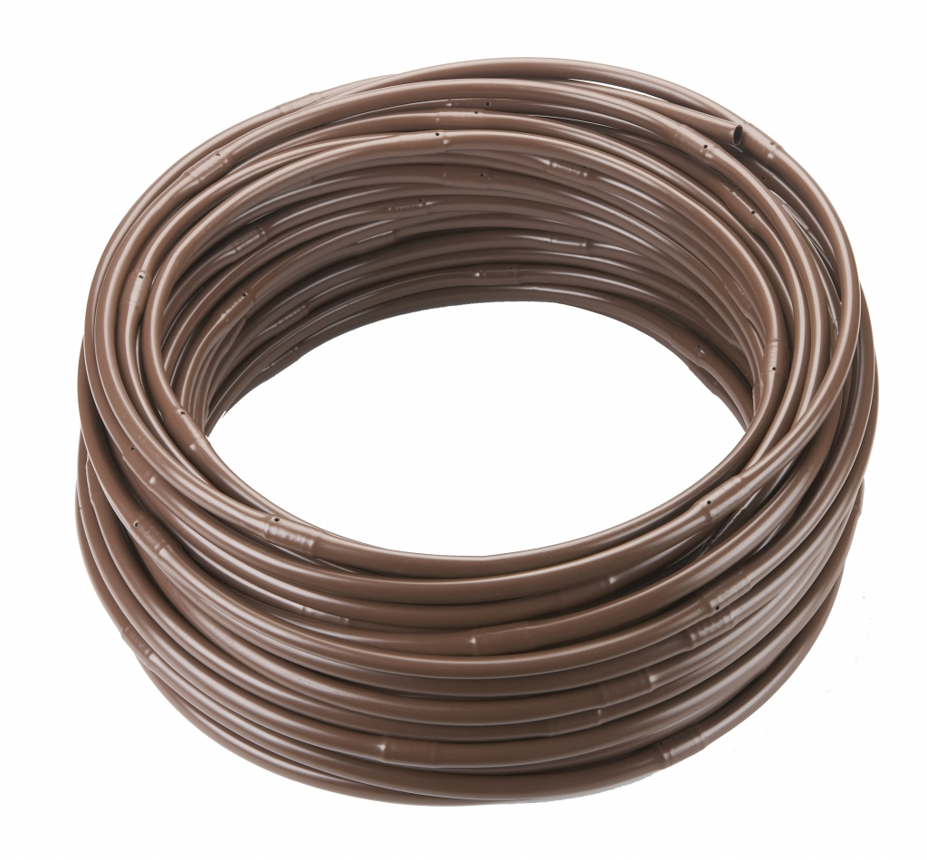
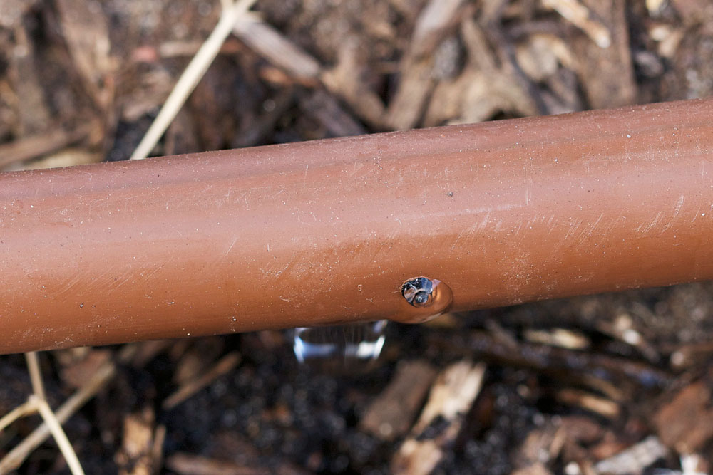

Slide 16
Drip Tube

Slide 17
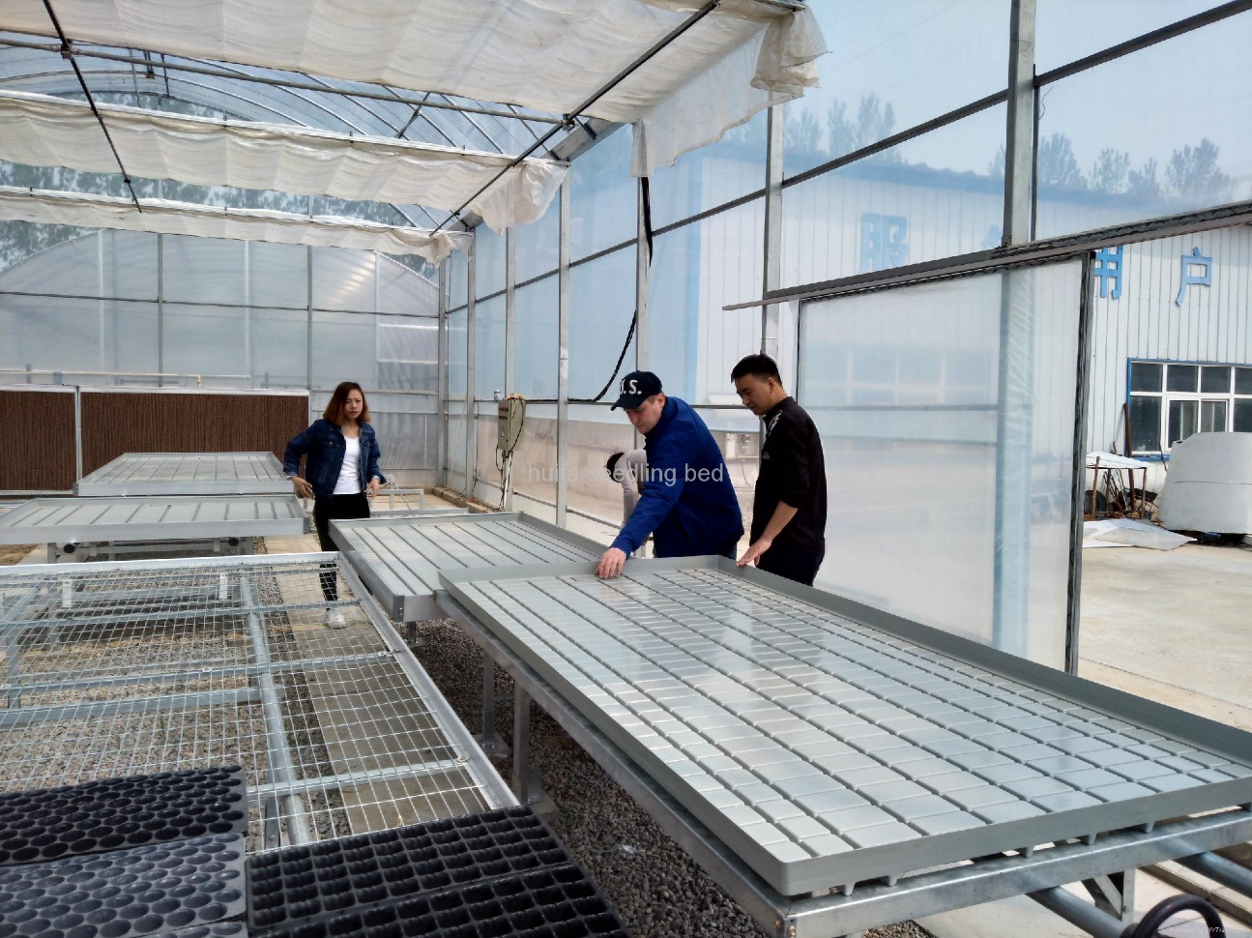

Slide 18
Ebb and Flow Irrigation

Slide 19
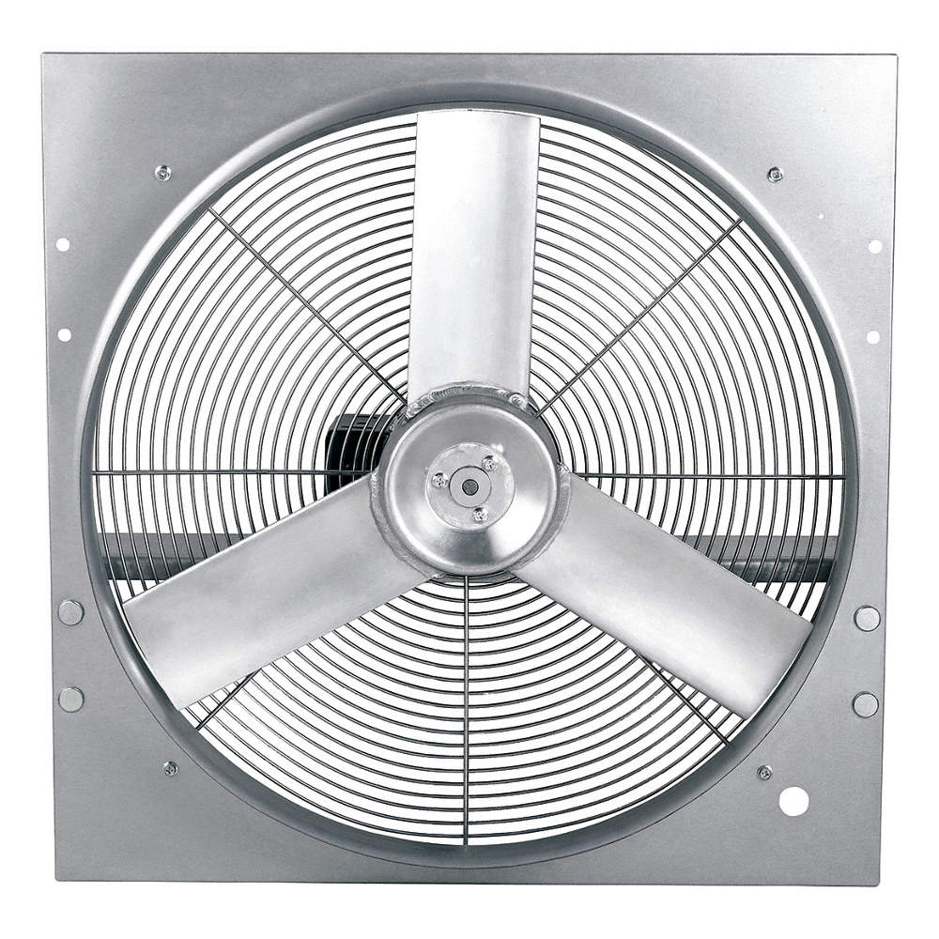
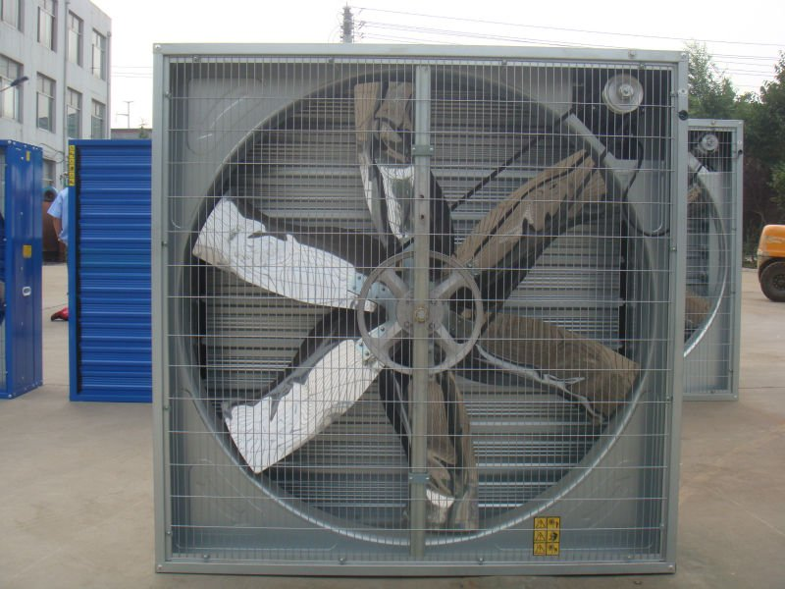

Slide 20
Exhaust Fan

Slide 21
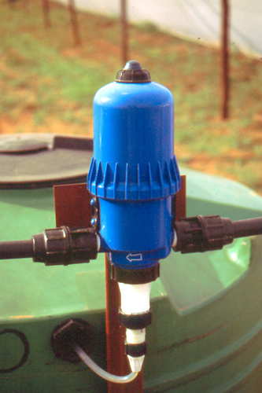
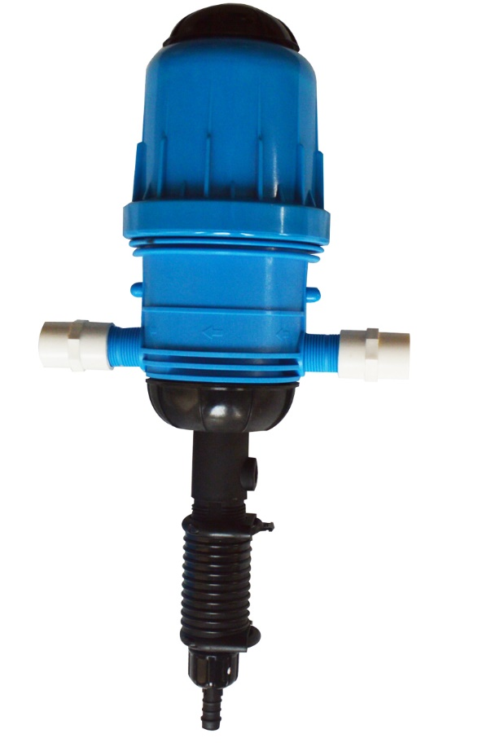

Slide 22
Fertilizer Injector

Slide 23
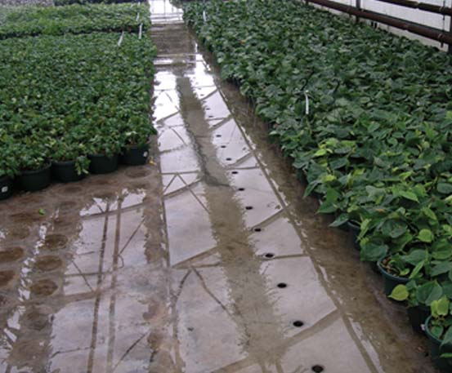

Slide 24
Flood system

Slide 25
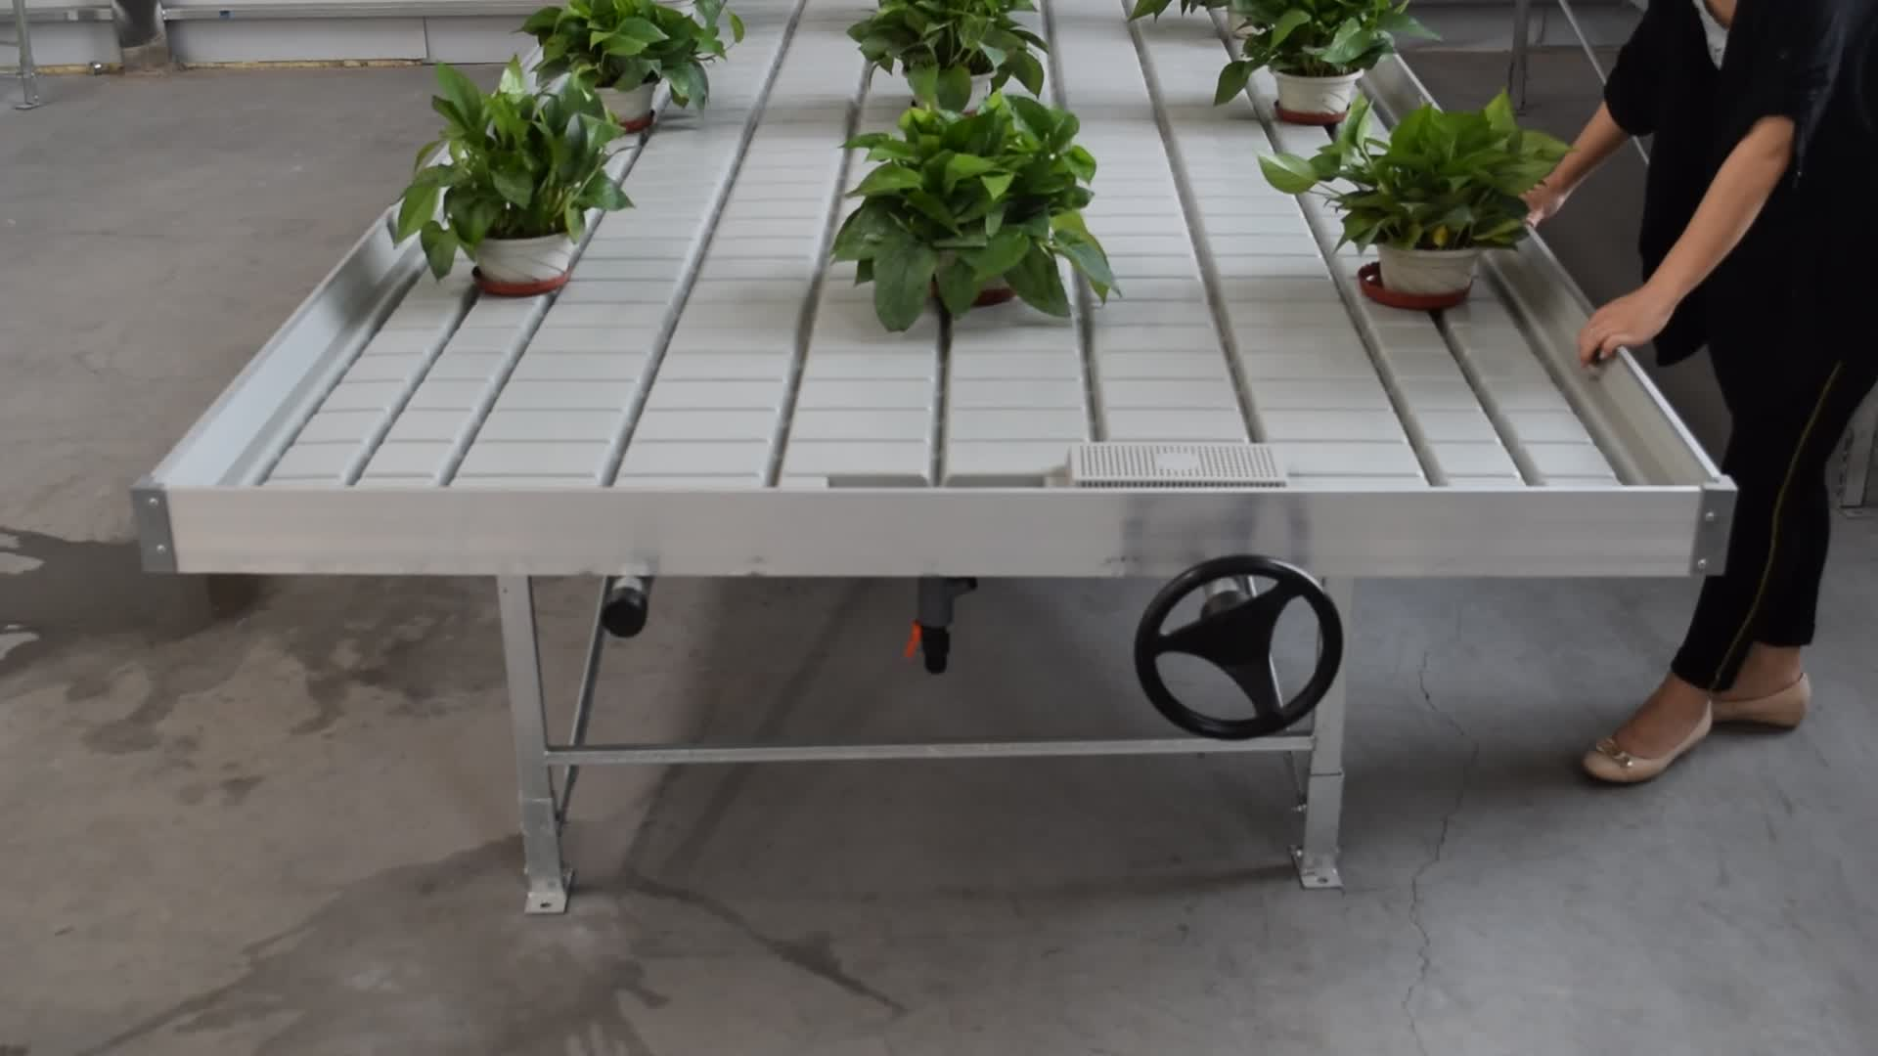
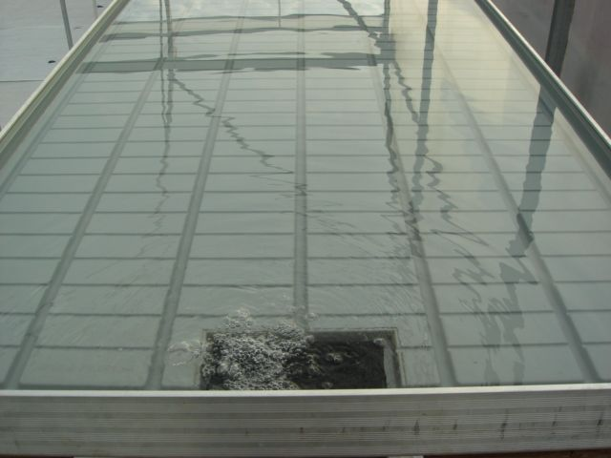

Slide 26
Flood Table

Slide 27
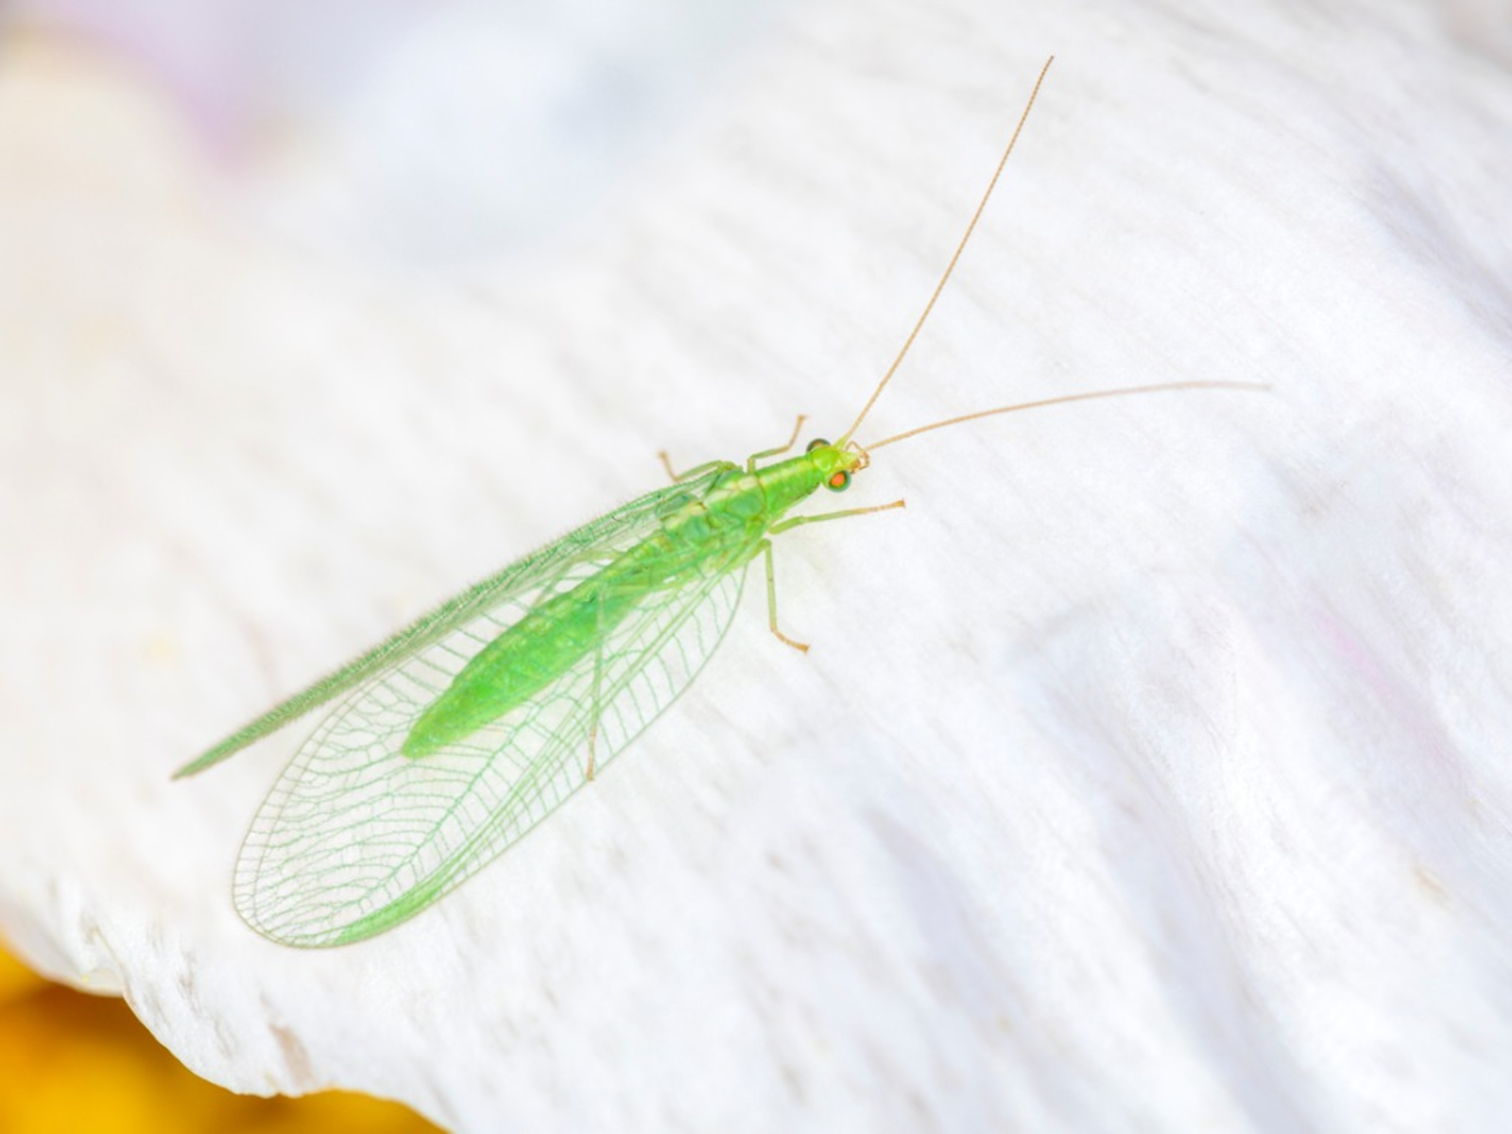

Slide 28
Green Lacewing

Slide 29
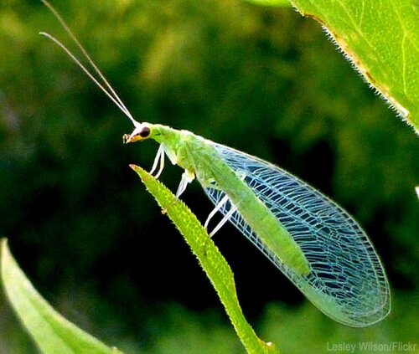

Slide 30
Green Lacewing

Slide 31
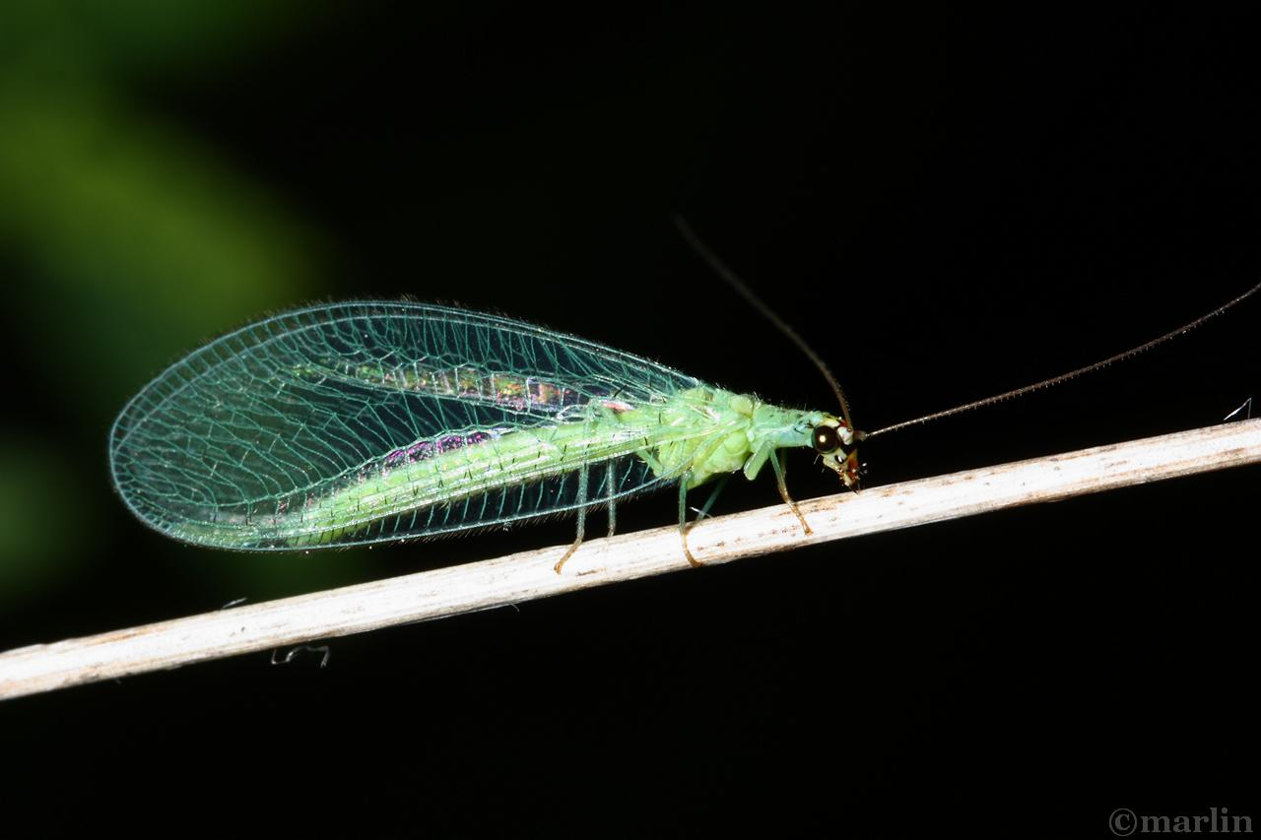

Slide 32
Green Lacewing

Slide 33
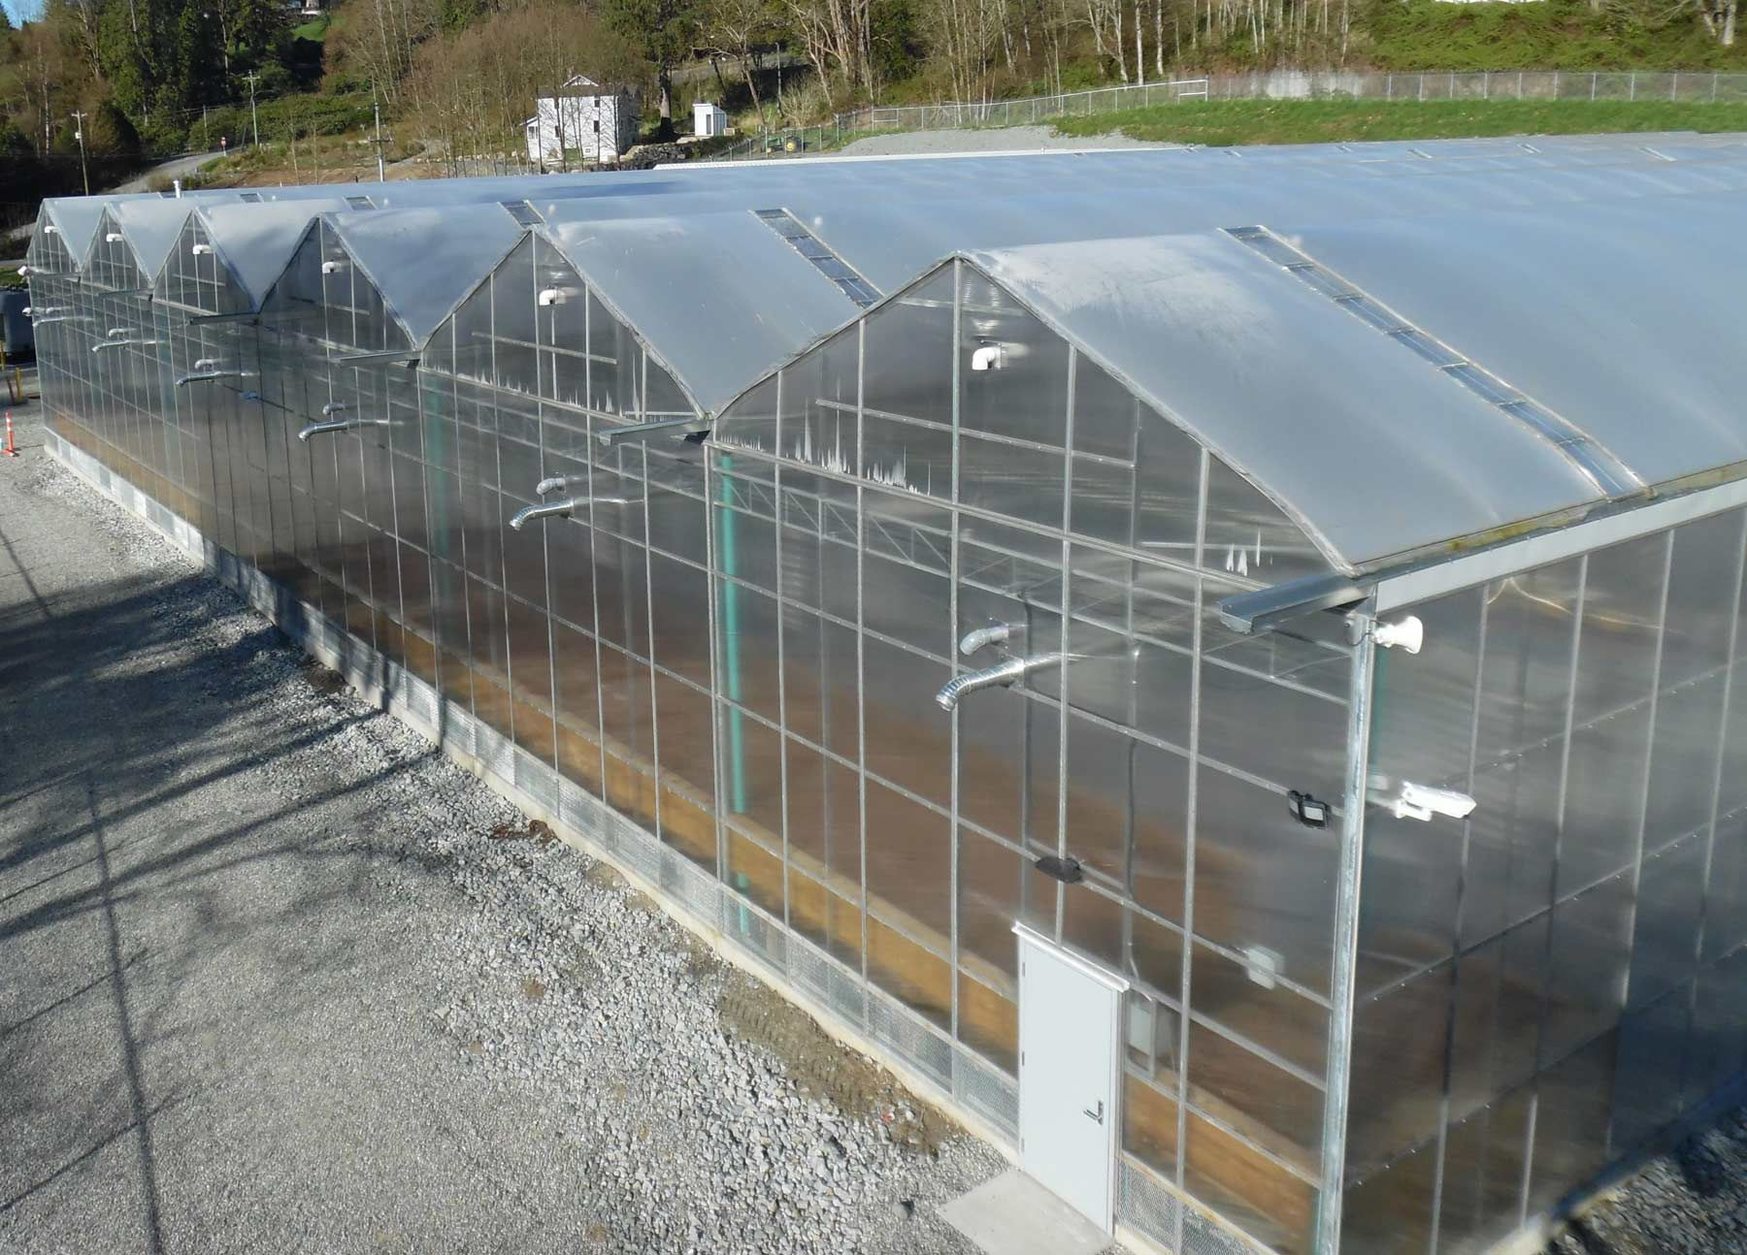

Slide 34
Gutter Connected
Greenhouse

Slide 35
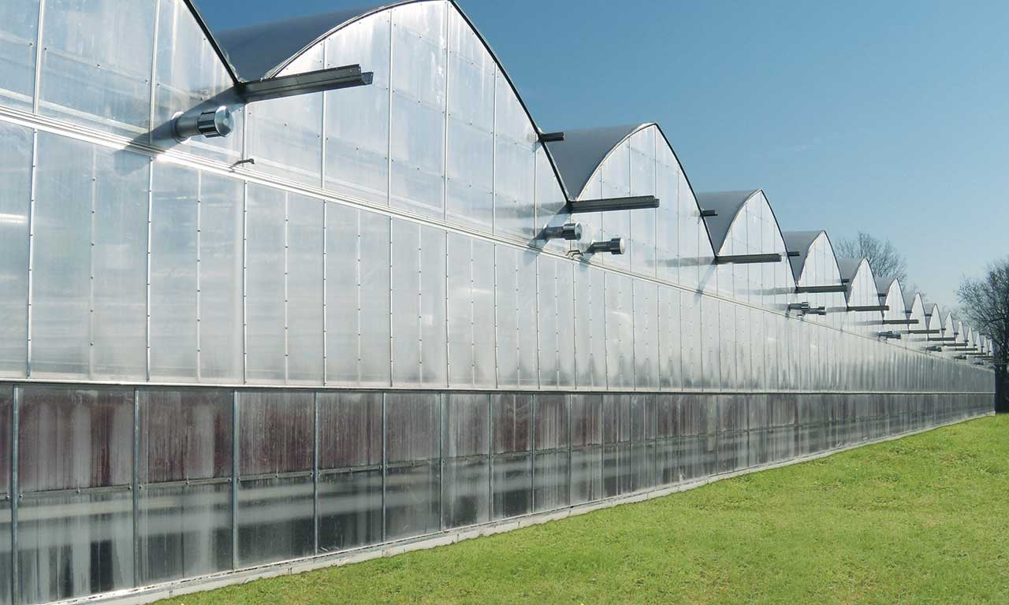

Slide 36
Gutter Connected
Greenhouse

Slide 37
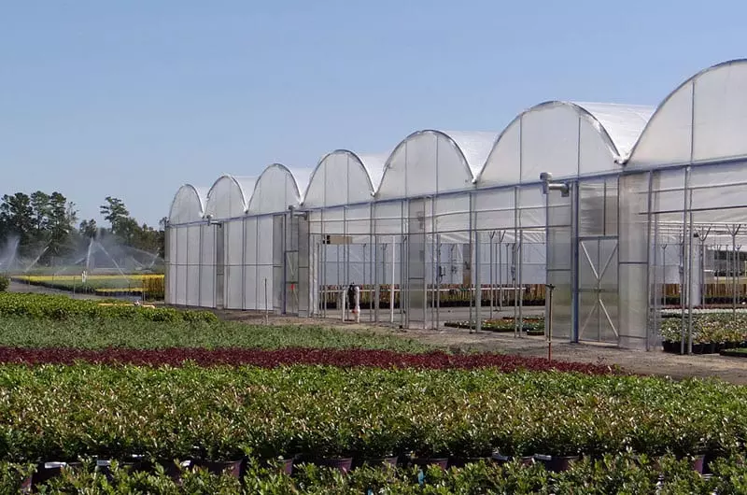

Slide 38
Gutter Connected
Greenhouse

Slide 39
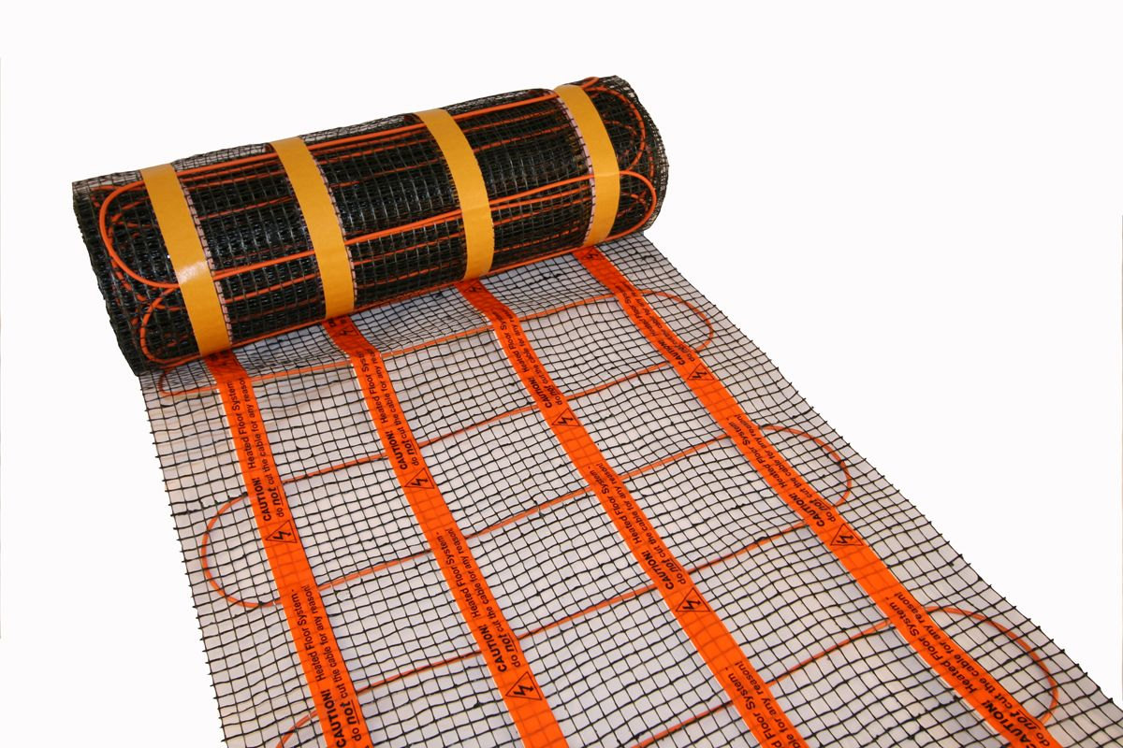

Slide 40
Heat Mat

Slide 41
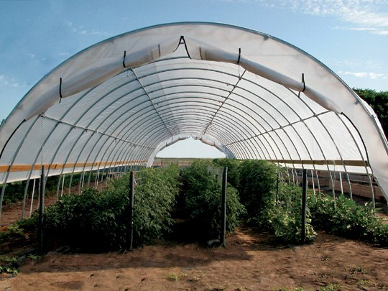
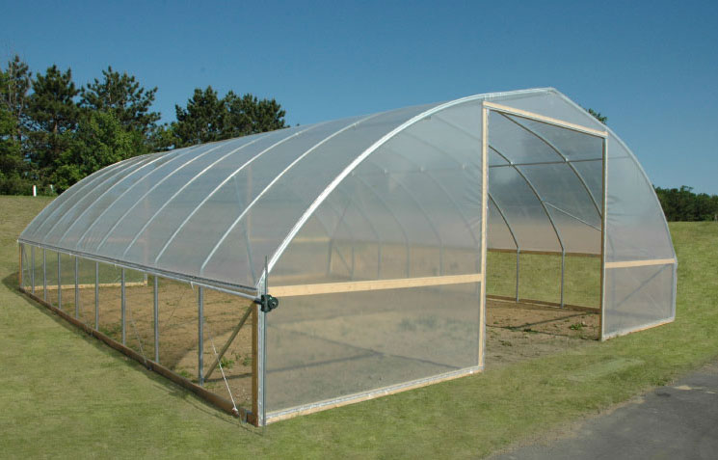

Slide 42
High Tunnel

Slide 43
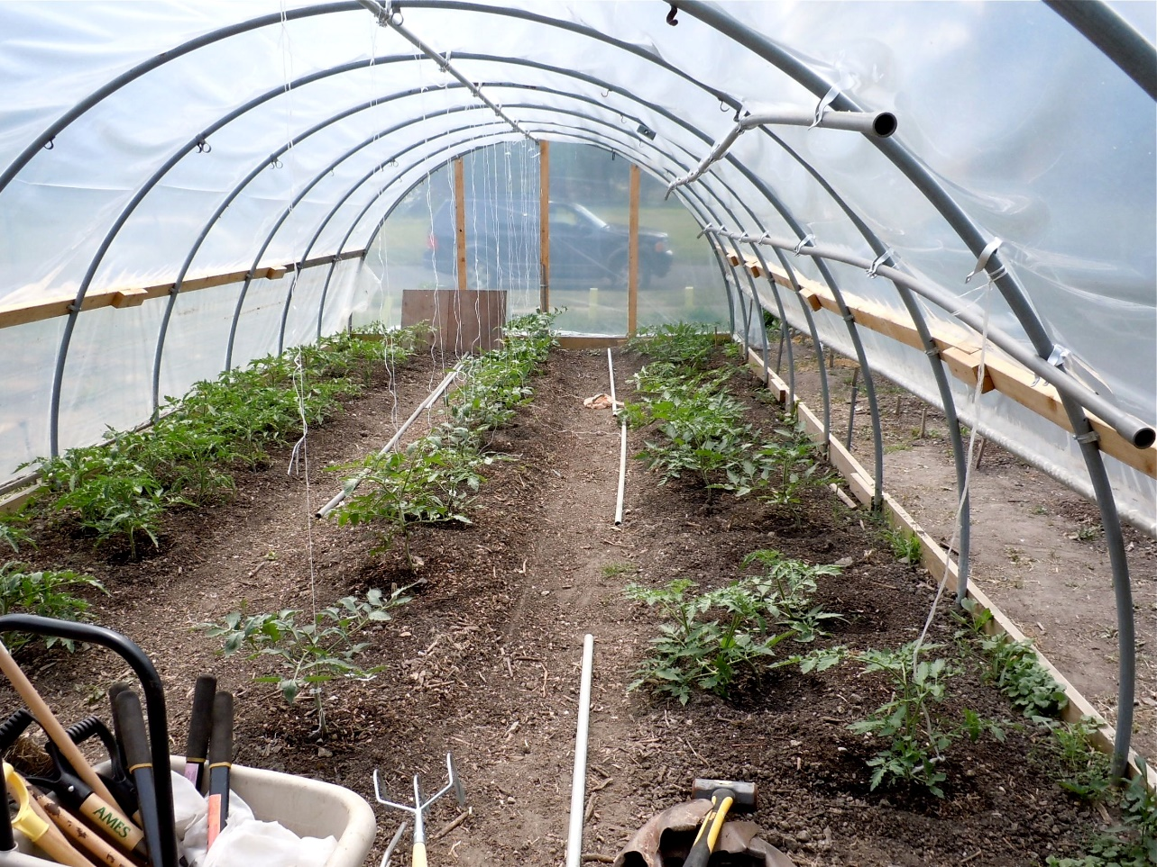
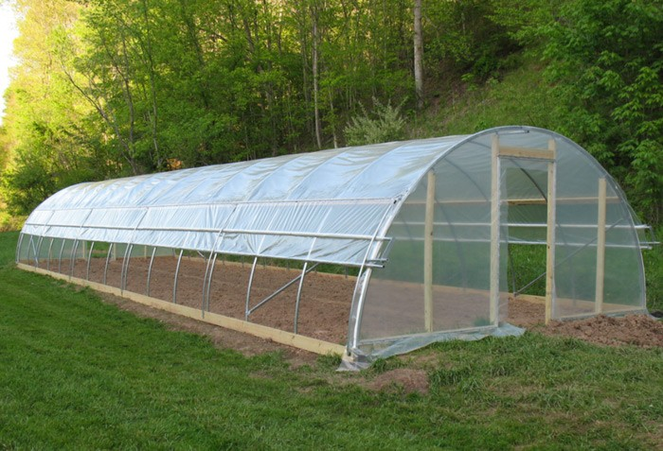

Slide 44
Hoop House

Slide 45
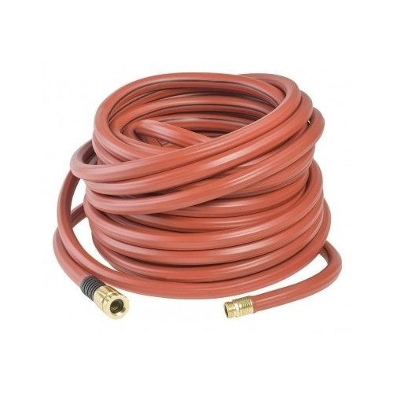
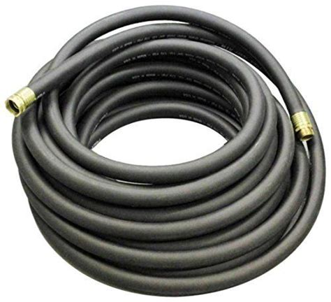

Slide 46
¾” Hose

Slide 48
Irrigation Controller

Slide 49
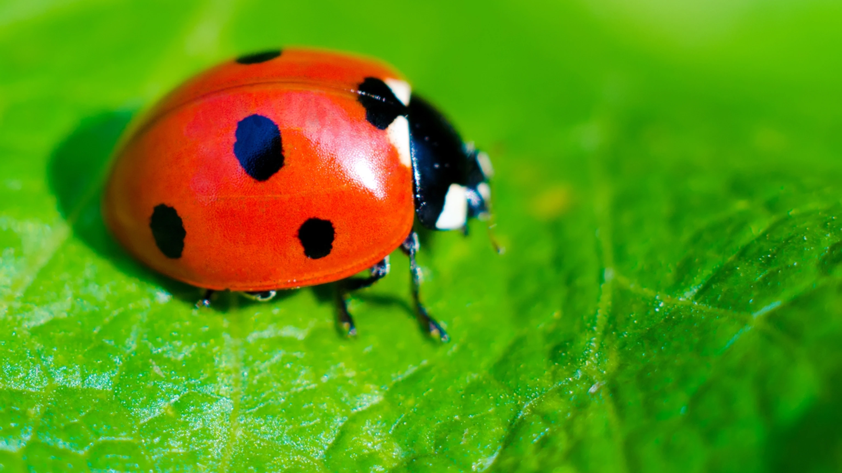

Slide 50
Lady Bug

Slide 51
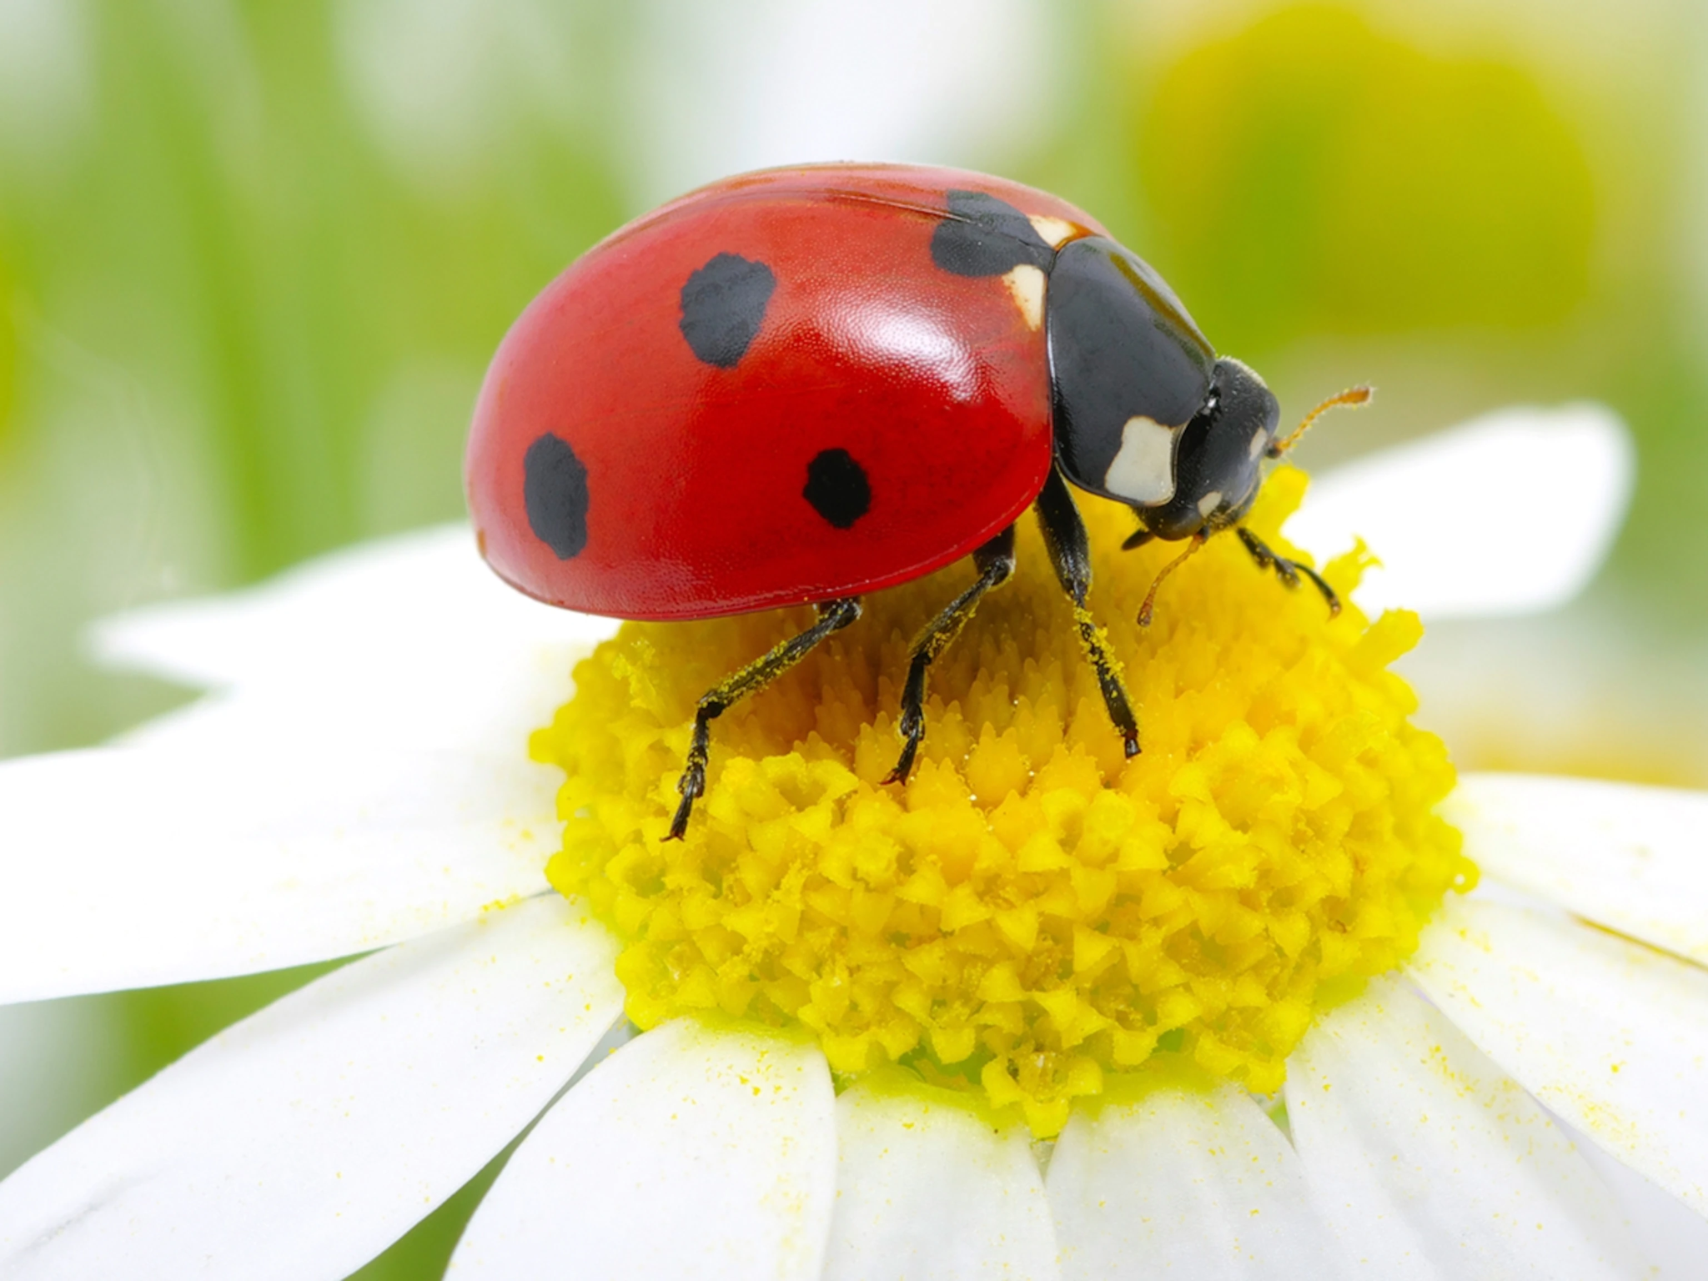

Slide 52
Lady Bug

Slide 53
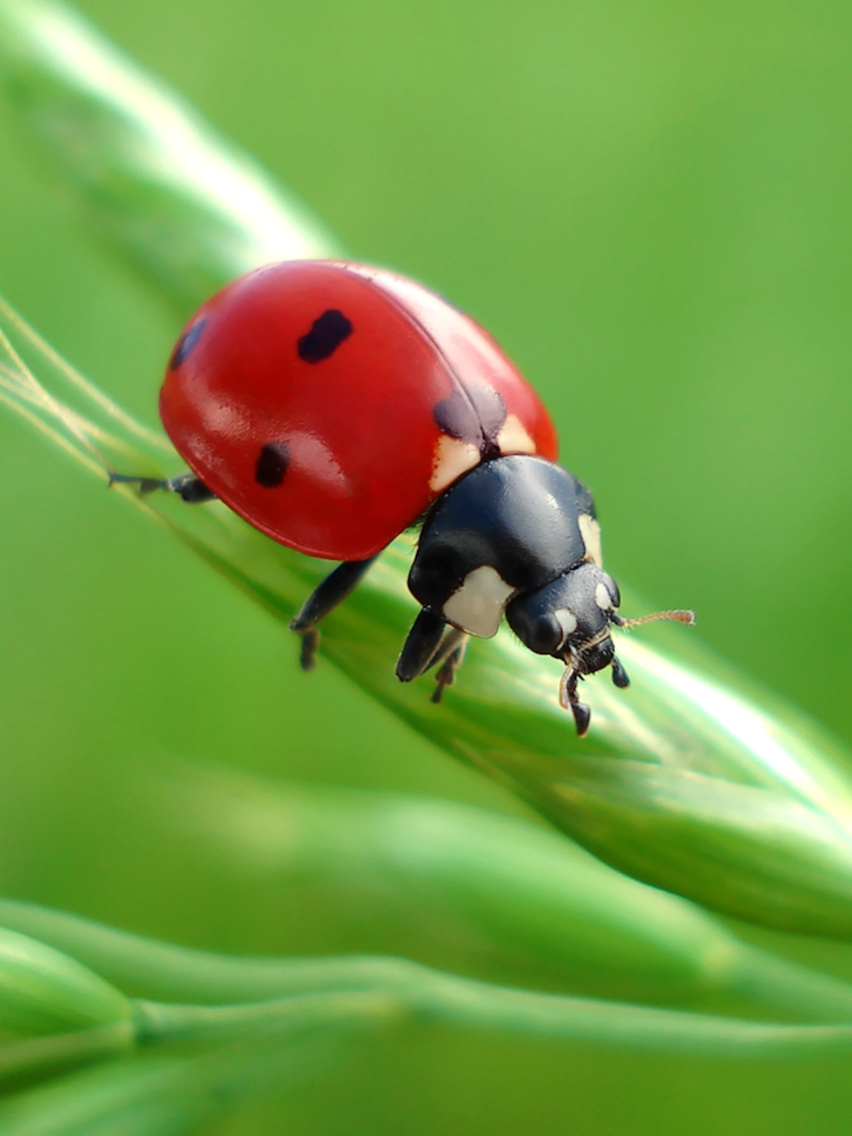

Slide 54
Lady Bug

Slide 55
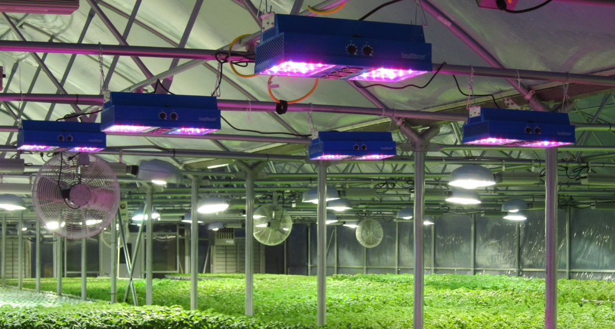
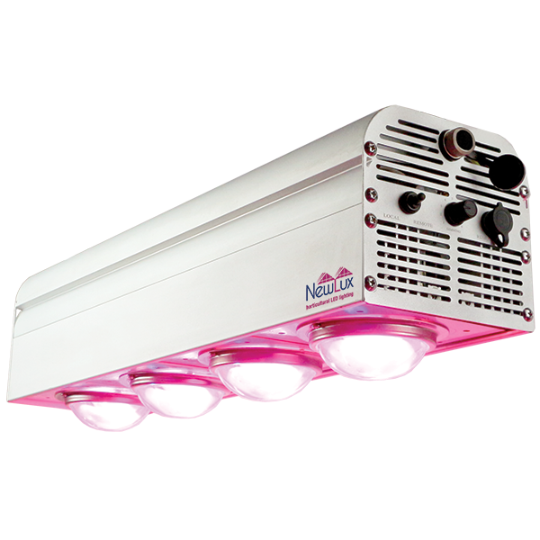

Slide 56
LED Light

Slide 57
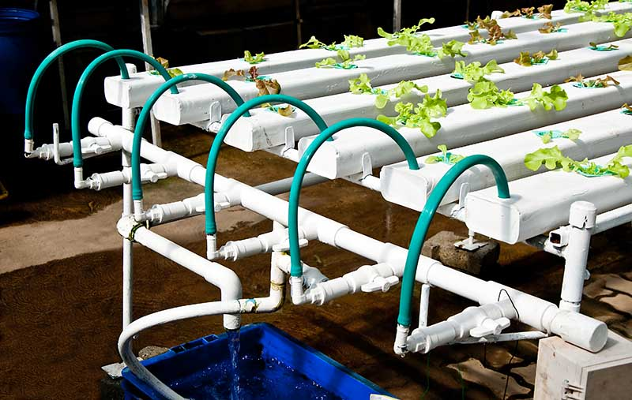

Slide 58
NFT System

Slide 59
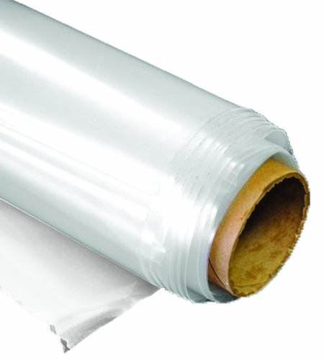

Slide 60
Polyethylene Film

Slide 62
Polyethylene Tubing

Slide 63
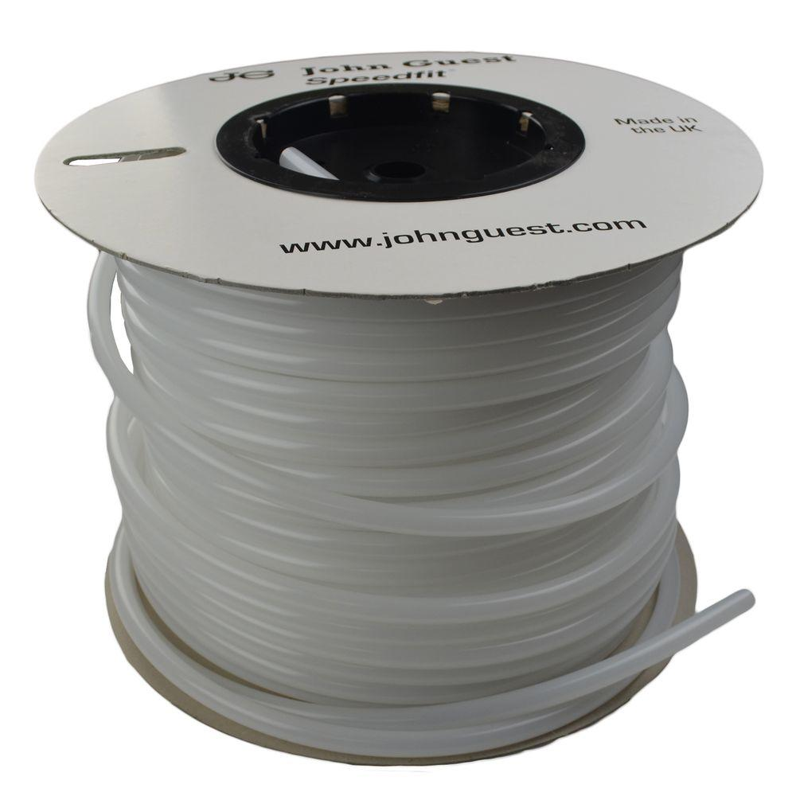

Slide 64
Polyethylene Tubing

Slide 65
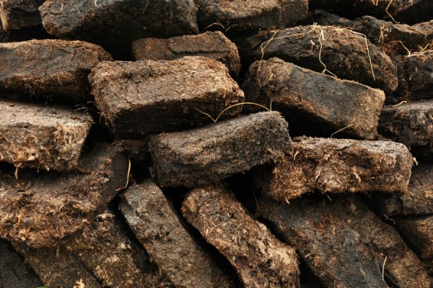
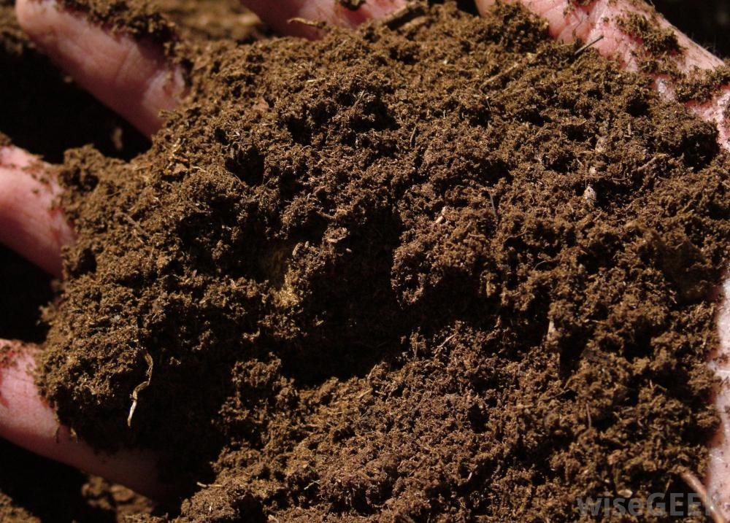

Slide 66
Peat

Slide 67
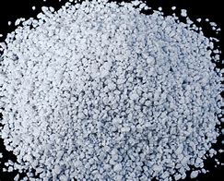
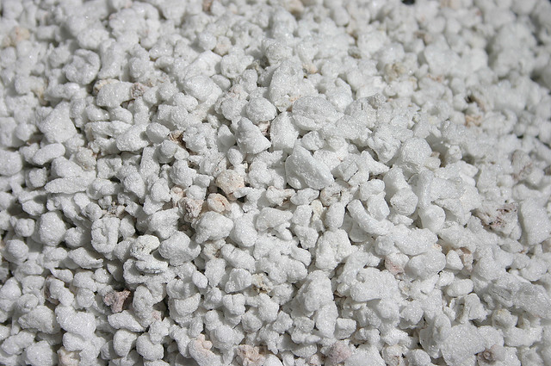

Slide 69
Pesticide Sprayer

Slide 70
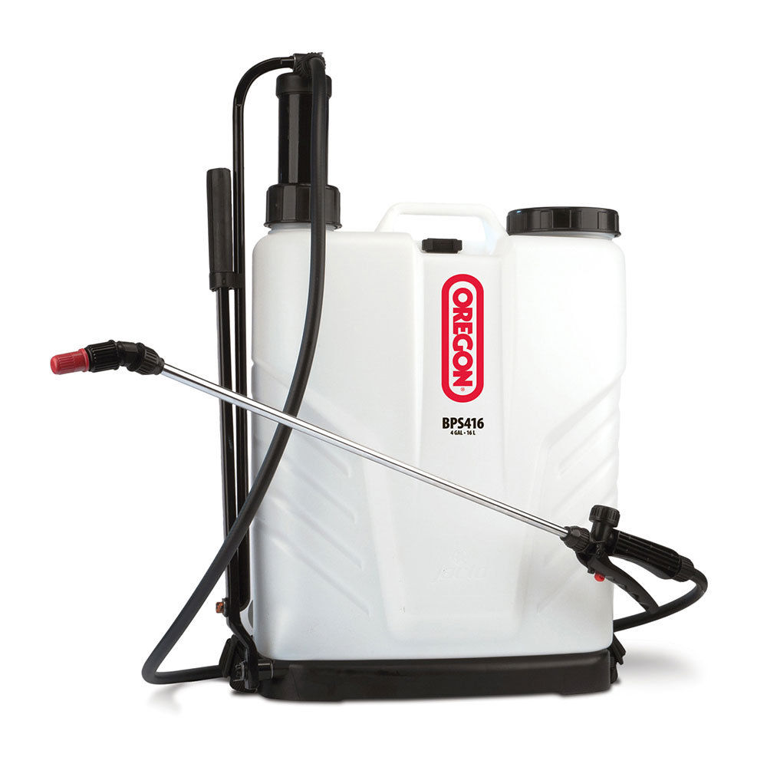

Slide 71
Pesticide Sprayer

Slide 72
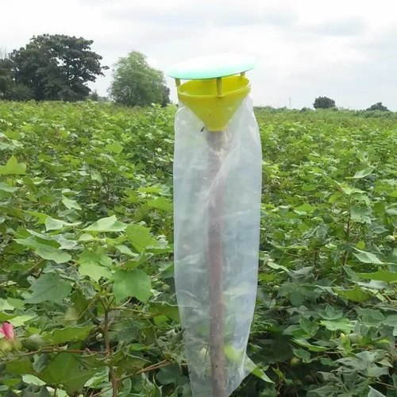

Slide 73
Pheromone Trap

Slide 74
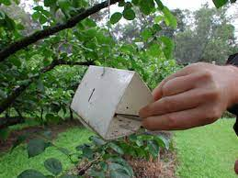

Slide 75
Pheromone Trap

Slide 76
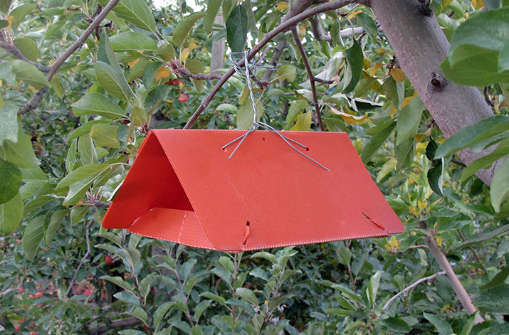

Slide 77
Pheromone Trap

Slide 78
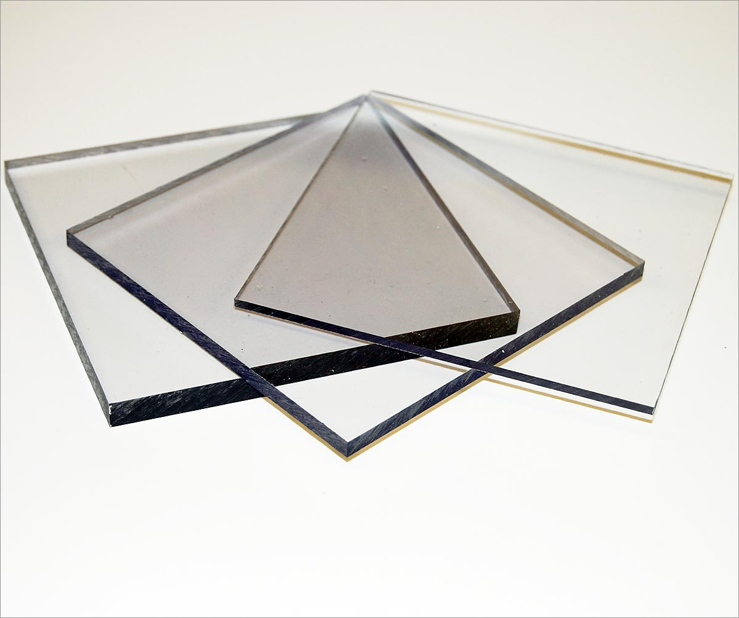

Slide 79
Polycarbonate

Slide 80
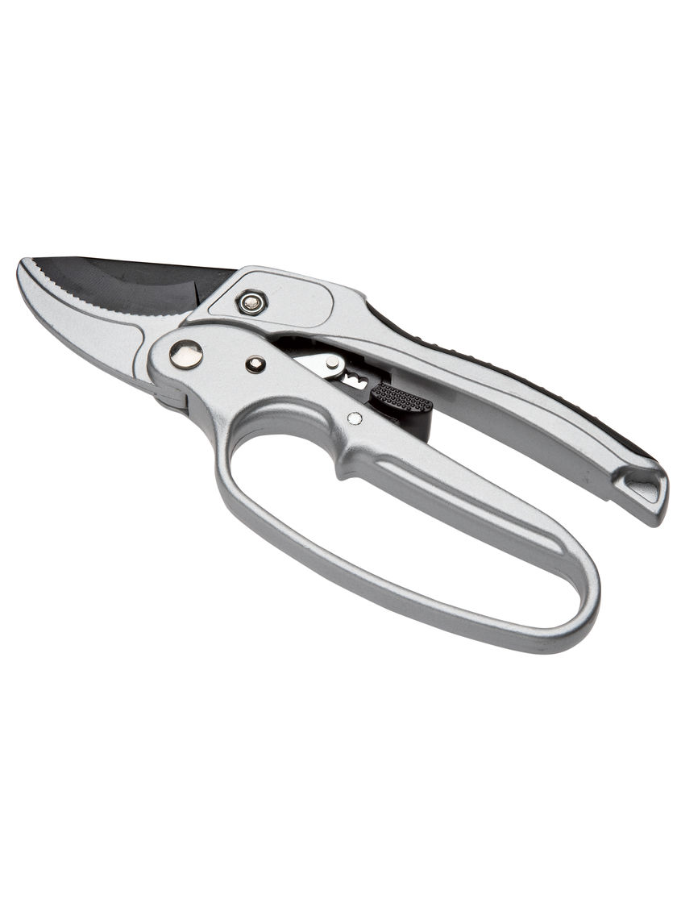
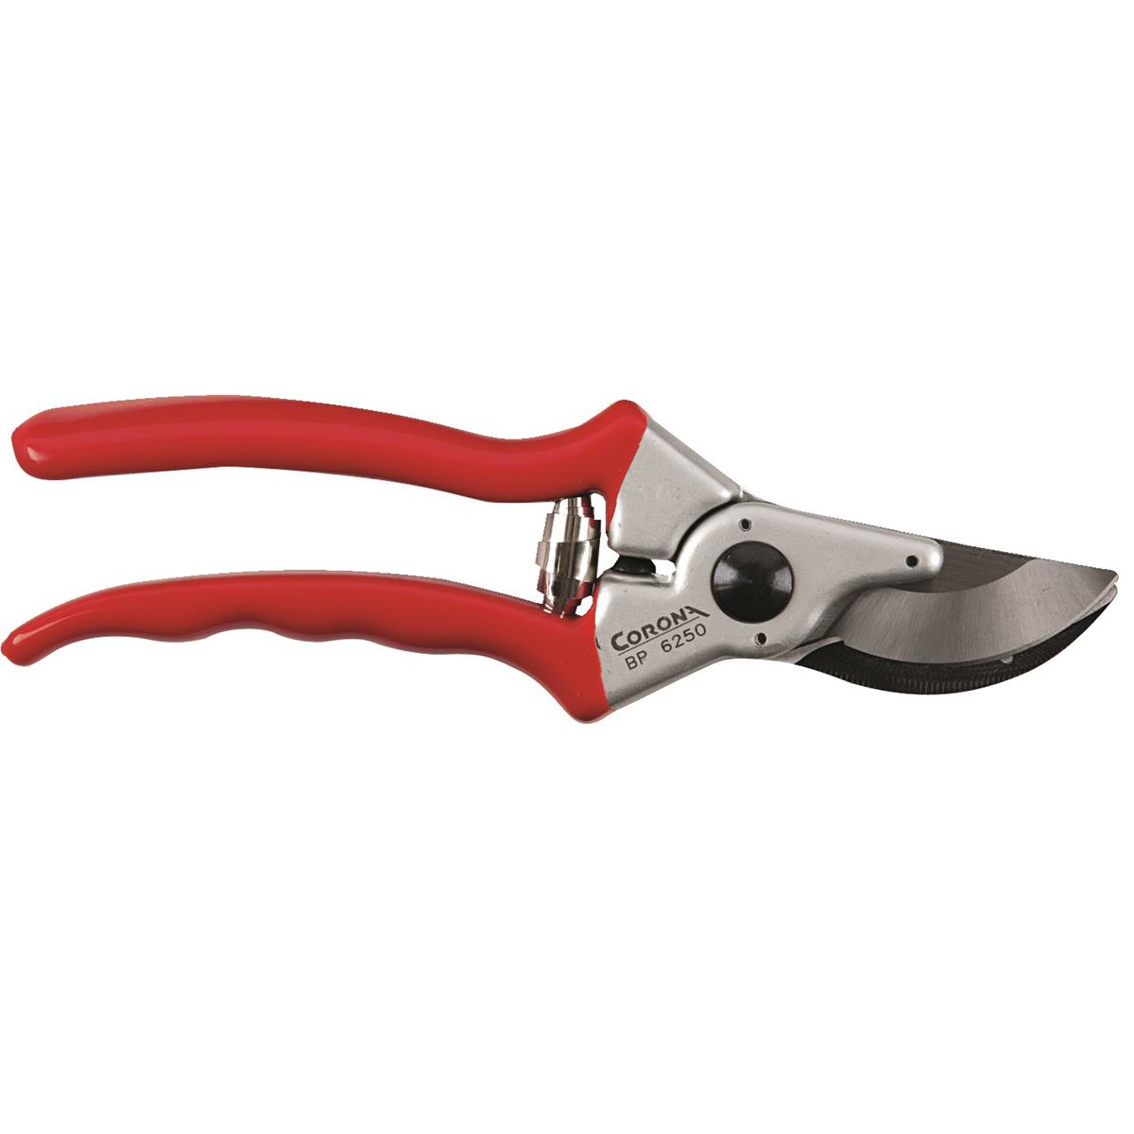

Slide 81
Pruners

Slide 82
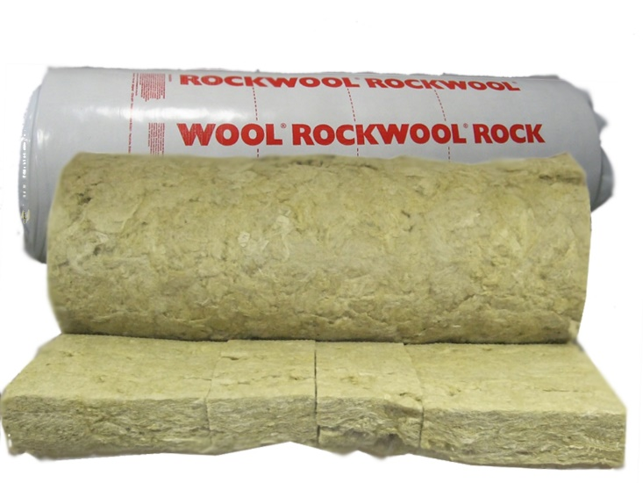

Slide 83
Rock Wool

Slide 85
Roof Vent

Slide 87
Reservoir Tank

Slide 89
Shade Cloth

Slide 91
Shuttle Tray

Slide 93
Solar Panel

Slide 95
Tags

Slide 97
Tags

Slide 99
Tags

Slide 101
Thermostat

Slide 103
Vermiculite

Slide 105
Wasp

Slide 107
Wasp

Slide 109
Wasp

Slide 111
Water Pump

Slide 113
Watering Wand

Slide 115
Yellow Sticky Board

Slide 117
Yellow Sticky Board

Slide 119
Yellow Sticky Board

